Slide 1

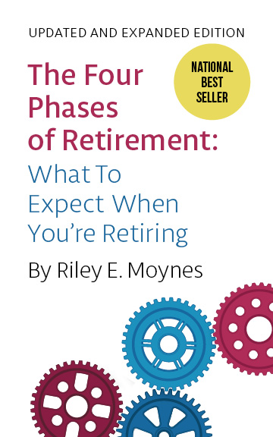
thefourphases.com
rileymoynes@rogers.com
Notes:
JOKE:
Did you know?
Toronto's the only place on earth where Maple Leafs fall in the Spring rather than the Autumn.

Slide 2
Everyone says you have to get ready to retire financially.
Of course you do, but what they don’t tell you is that you have to get ready psychologically.
Notes:
WHO KNEW?
BUT IT'S IMPORTANT AS YOU'LL SEE

Slide 3
BACKGROUND
The first Baby Boomers (born 1946-65) hit retirement age (65) in 2011.
Today about 46% of Boomers have reached age 65.
The last Boomer will turn 65 in 2030.
Notes:
SO LET's START WITH SOME OF THE RESEARCH.....
SPEAKING OF RESEARCH, allow me to share this with you.... 1/3...1/3 1/3

Slide 4
TODAY AND TOMORROW
10,000 North Americans retire every day.
For the next several years…
Notes:
10,000 a day…THINK ABOUT THAT!

Slide 5
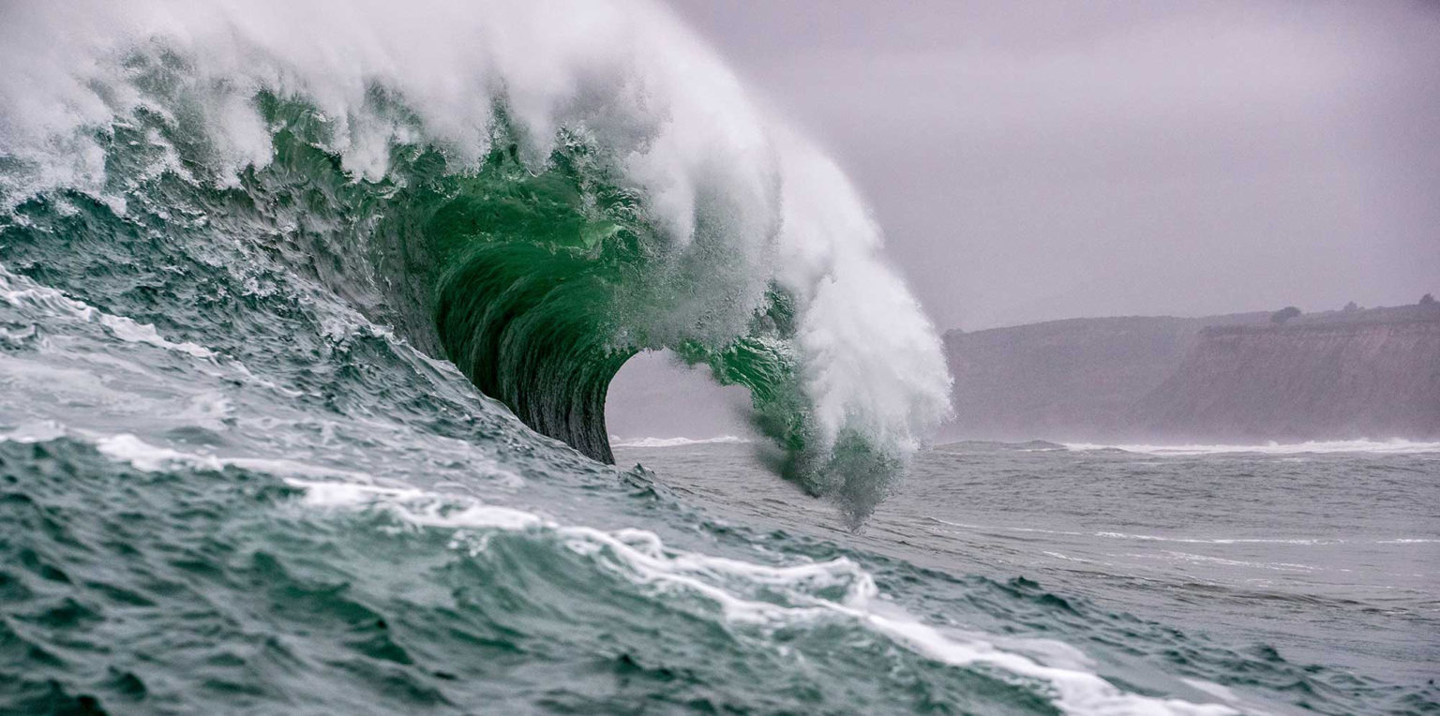
Notes:
IT'S LIKE A RETIREMENT TSUNAMI!

Slide 6

LIFE EXPECTANCY
1950—68 (3)
2000—76 (11)
2010—81 (16)
2021—82 (17)
2022—81.3
Notes:
THESE FIGURES PROVIDED BY THE ACTUARIES/ STATISTICIANS AND ACCOUNTANTS AT STATS CAN AND INSURANCE COMPANIES
JOKE ABOUT ACTUARIES/ACCOUNTANTS

Slide 7
LIFE EXPECTANCY
Fastest growing age group in North America currently is 85+
Second fastest growing group is 100+
Many here today can expect to live up to one-third of our lives in retirement.
Notes:
WE ARE AN AGING SOCIETY

Slide 8
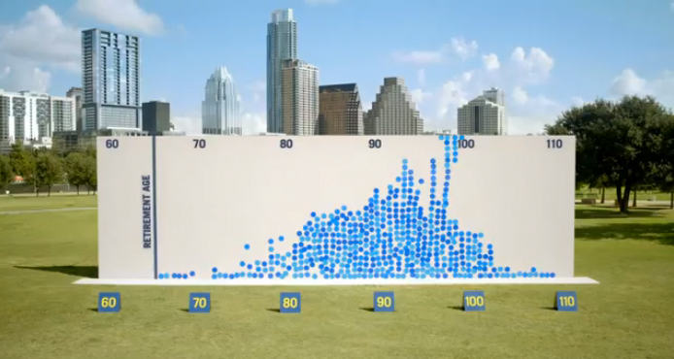
Living Proof That We All Need To Plan For A Longer Retirement
Notes:
Explain Prudential exercise. So we’re living longer than ever before…up to 1/3 of our lives in retirement. The question is: HOW DO WE SPEND THAT TIME PRODUCTIVELY AND MEANINGFULLY?

Slide 9
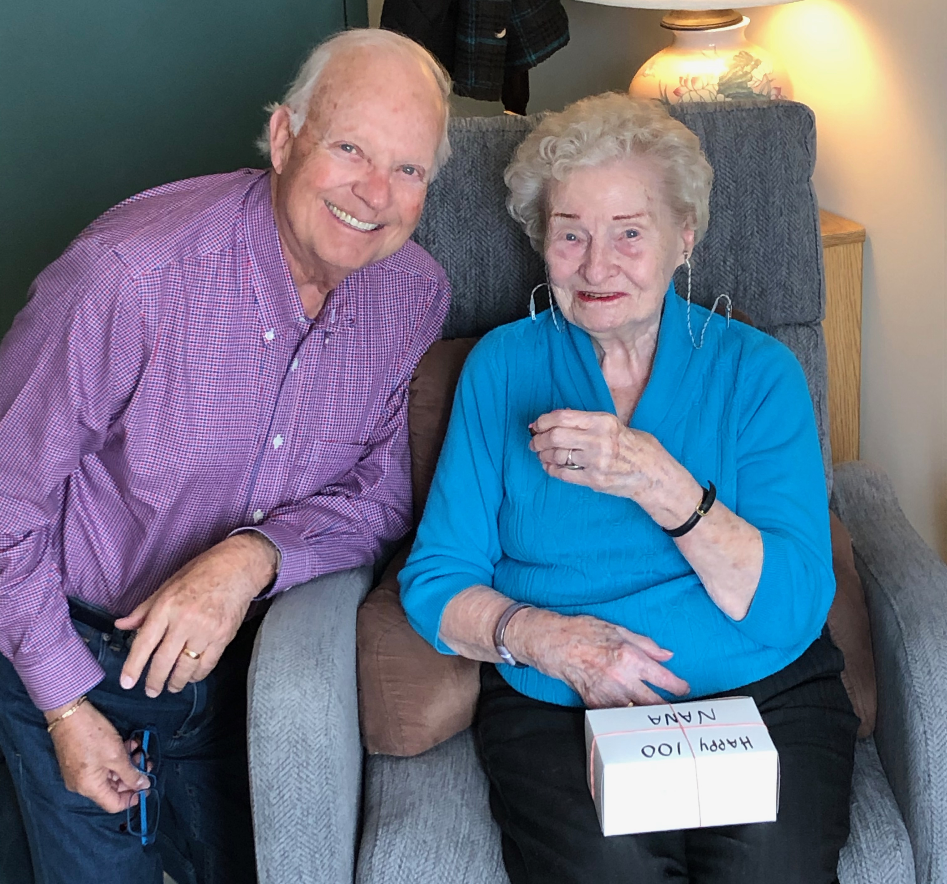
Notes:
MY MOM IS 101
"THIS IS WHAT IT LOOKS LIKE"

Slide 10
LET ME TELL YOU
A STORY…
Notes:
WALKING GROUP; 3X WEEK; 10,000 STEPS;
COFFEE...AND CINAMMON BUNS
HOW CAN YOU 'SQUEEZE ALL THE JUICE' OUT OF RETIREMENT?
THOUGHT I HAD A GOOD IDEA OF SUCCESS IN A WORKING CAREER....BUT

Slide 11
Success in retirement was “fuzzier” for me.
Notes:
STUDIED THE MATERIAL...IMPORTANT STUFF...BUT NOT WHAT I WAS LOOKING FOR
SO I INTERVIEWED DOZENS OF RETIREES AND ASKED THEM THE QUESTION..

Slide 12
I DISCOVERED
There IS a framework and pattern that
can help.
If you know what you’re looking for…
Notes:
I WANT TO SHARE THAT FRAMEWORK WITH YOU TODAY

Slide 13
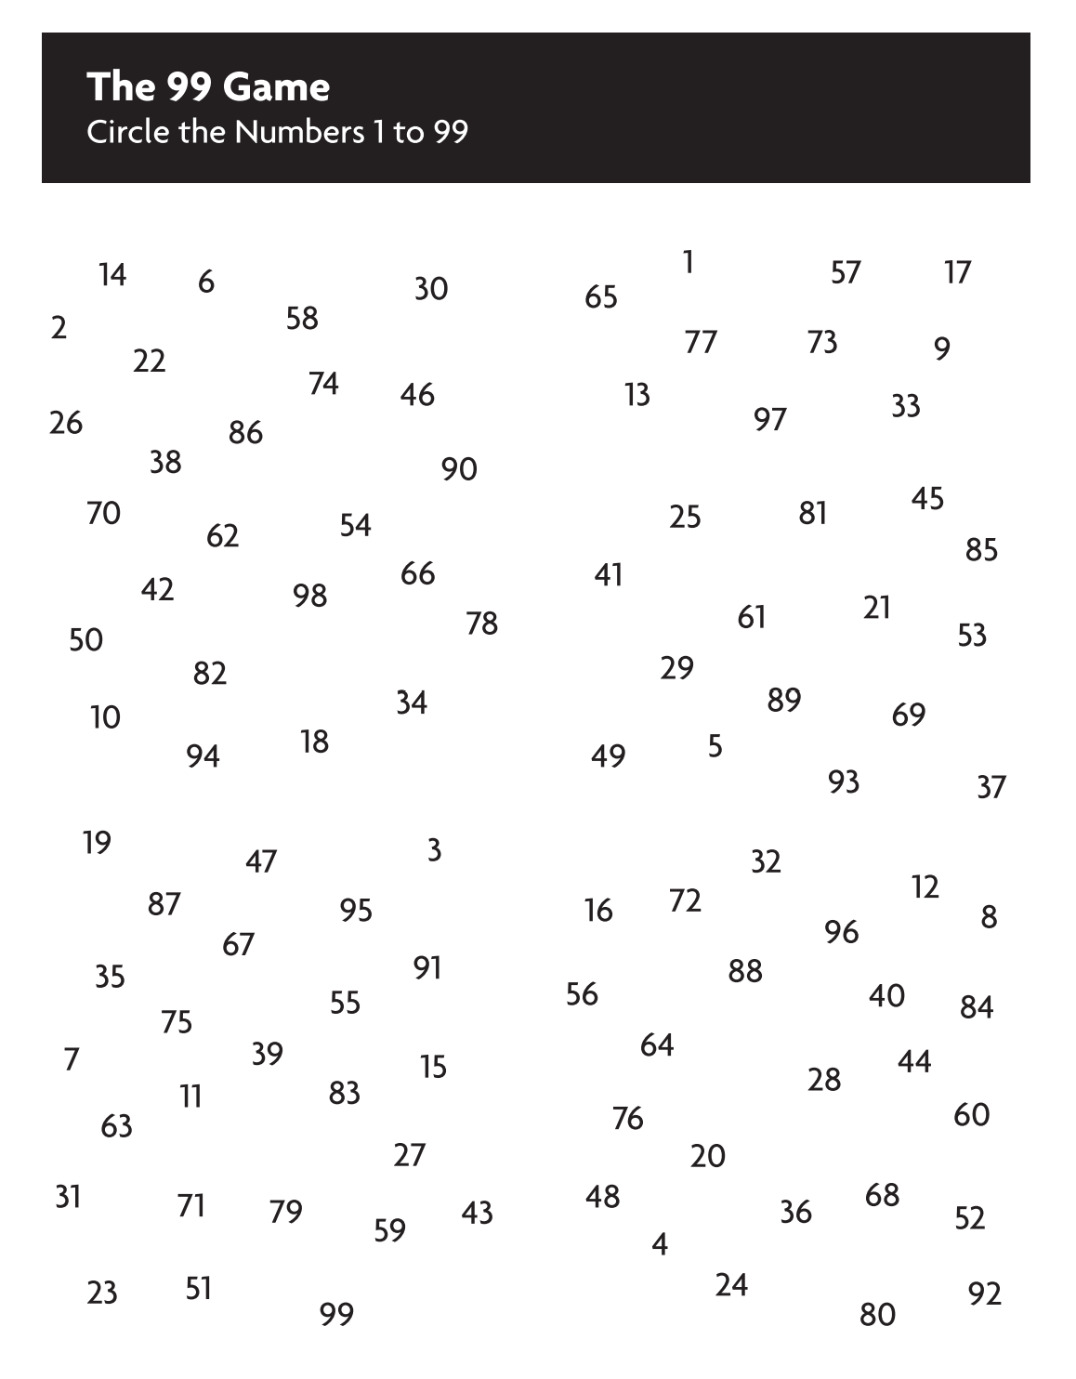

Notes:
INTRO 99 GAME

Slide 14
Notes:
WHY GO FURTHER 2ND TIME?
PLAN/ KNEW WHAT LOOKING FOR/FRAMEWORK HELPS

Slide 15
WHEN WE’RE FINISHED
You’ll know The Four Phases of Retirement.
If retired, you’ll know which Phase you’re in now.
If you’re not, you’ll know what to expect when the time comes.
Notes:
ABOUT 40 MINUTES FROM NOW…AT THE END OF OUR BRIEF TIME TOGETHER,
FOUR PHASES IS OUR FRAMEWORK!
DO YOU KNOW THE CLOCKS IN HEAVEN STORY??
LET’S GET STARTED!

Slide 16
Two assumptions
Notes:
ABOUT 40 MINUTES FROM NOW…AT THE END OF OUR BRIEF TIME TOGETHER,
FOUR PHASES IS OUR FRAMEWORK!
DO YOU KNOW THE CLOCKS IN HEAVEN STORY??
LET’S GET STARTED!

Slide 17
PHASE #1 Vacation Phase
1-2 years
“Bucket List” activities predominate.
You appreciate having no set routine for the time being.
Freeeedom!!
Notes:
FOR MOST, PHASE 1 REPRESENTS THEIR VIEW OF AN IDEAL RETIREMENT...RELAXING, ENJOYING FUN VACATION...FREEDOM

Slide 18

Notes:
FOR MOST, PHASE 1 REPRESENTS THEIR VIEW OF AN IDEAL RETIREMENT...RELAXING, ENJOYING FUN VACATION...FREEDOM

Slide 19
BUT THEN…
Get a bit bored.
Miss a routine.
“Is that all there is to retirement?”
Notes:
WHEN WE ASK THIS QUESTION, YOU KNOW YOU'VE ENTERED PHASE 2

Slide 20
RETIREMENT: “a plunge into the abyss of insignificance”
One of life’s Top Ten Traumas.
Notes:
IN PHASE 2, WE THINK OF RETIREMENT AS...

Slide 21

PHASE # 2 Feeling Loss and Feeling Lost
Five Significant, Unavoidable Losses
We lose:
Structure
Identity
Relationships
A sense of purpose
A sense of power
Notes:
WE DON'T SEE THESE LOSSES COMING, AND BECAUSE WE LOSE THEM ALL AT THE SAME TIME...
POOF! GONE!
IT CAN BE VERY TRAUMATIC.....
AND IT GETS WORSE!

Slide 22
PHASE # 2 Feeling Loss and Feeling Lost
At greater risk for:
Depression
Decline
Divorce
In North America, divorces among people over 50 have doubled; for those over 65, the rate has tripled since 1990.
Notes:
WORLD FAMOUS MAYO CLINIC SAYS:
40% LIKLIHOOD THAT YOU'LL EXHIBIT SIGNS OF CLINICAL DEPRESSIONWHEN YOU RETIRE!
HIGHEST SUICIDE RATES IN CANADA??
MEN OVER 75!!

Slide 23
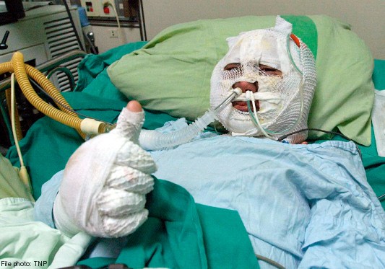
THE RESULT OF ALL THIS…
Notes:
WE CAN FEEL LIKE WE’VE BEEN HIT BY A BUS…

Slide 24
Fear…
Uncertainty…
Anxiety…
Buckle up!
Notes:
BEFORE WE CAN EXPERIENCE SOME OF THE JOYS OF PHASES 3 AND 4,
WE'LL EXPERIENCE...
SO, "BUCKLE UP!"
BUT SOONER OR LATER....

Slide 25
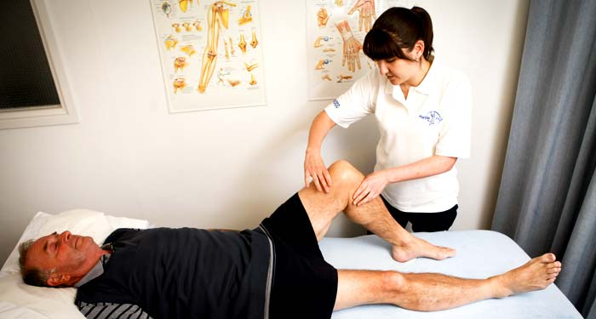
AND SO THE REHAB BEGINS…
Notes:
BUT LUCKILY, AT SOME POINT, MOST OF US SAY:
I CAN'T GO ON LIKE THIS
I DON'T WANT TO SPEND 1/3 OF MY LIFE...PERHAPS 30 YEARS...FEELING LIKE THIS!
AND WHEN WE DO, THE REHAB BEGINS...AND WE'VE MOVED INTO PHASE 3

Slide 26
PHASE #3 Trial and Error
You Know You’re In Phase Three When…
You ask, “What can I do to make my life meaningful and productive again?”
You ask, “How can I still contribute?”
You understand it often involves false starts.
Notes:
CONDO BOARD...TIRED OF BEING YELLED AT
LAW SCHOOL, PARALEGAL, DISPUTE RESOLUTION PROGRAM...WENT NOWHERE
MEMOIRS PROGRAM DEVELOPED...LIMITED SUCCESS...
IT'S BEEN A ROCKY ROAD FOR ME TOO...I TOLD YOU TO BUCKLE UP!
SOUNDS BAD, BUT MUST PERSIST AND FIND WHAT MAKES US WANT TO GET UP AGAIN IN THE MORNING!!
OTHERWISE...SLIP BACK TO PHASE 2

Slide 27
PHASE #4 Reinvent & Rewire
Not everyone breaks through and reaches Phase Four…
Notes:
SOME REMAIN IN PHASE 1, 2, or 3
SOME MOVE BETWEEN PHASES
BUT THOSE WHO DO...

Slide 28
…but those who do are some of the happiest people I’ve ever known.
Notes:
SOME REMAIN IN PHASE 1, 2, or 3
SOME MOVE BETWEEN PHASES
BUT THOSE WHO DO...

Slide 29
PHASE #4 Reinvent & Rewire
Breakthrough requires answering these questions:
What’s my mission here/my purpose?
How can I squeeze all the juice out of retirement?
HINT: It almost always involves service to others.
Notes:
INTROSPECTION REQUIRED...AND WE'RE NOT ALWAYS GOOD AT THAT

Slide 30
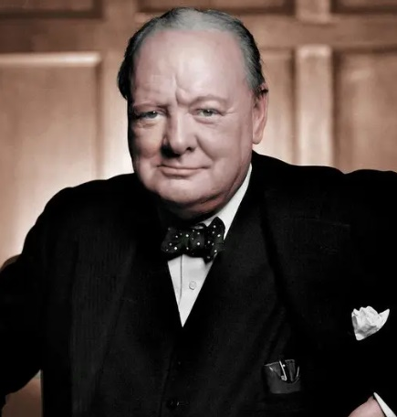
“We make a living by what we get;
we make a life by what we give.”
Winston Churchill
Notes:
I WANT TO SHARE FOUT TOOLS YOU CAN USE TO GET TO PHASE FOUR!

Slide 31
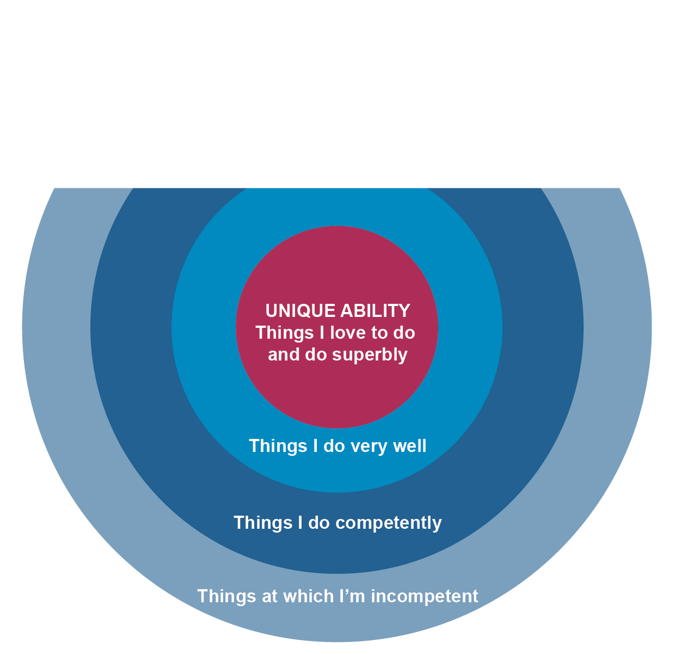
TOOL #1 Unique Ability

Slide 32
TOOL #1 Unique Ability
What’s My “Unique Ability”?
What do you love to do?
What do you do really well?
Notes:
HANDOUT #1
NOTE MY UNIQUE ABILITY

Slide 33

TOOL #2 High Points
Five successes, highlights, breakthroughs, or victories.
Notes:
HANDOUT #2

Slide 34

TOOL #3 Common Threads
What we love to do and do well leads to success.
Notes:
NO HANDOUT;
LOOK FOR OVERLAP BETWEEN #1 AND #2

Slide 35
TOOL #4 Finding Your Sweet Spot
what you
LOVE
what
you are
GOOD AT
Your
Sweet
Spot
past
SUCCESSES
what
you can be
PAID FOR
Notes:
HANDOUT #4
WHAT MAKES YOU WANT TO GET UP EVERY MORNING?
NOTE MY LIFE'S PURPOSE

Slide 36

“The unhappiest retirees had not
gone on to do anything productive beyond pleasing themselves.”
Harvard Business School Study
Notes:
20 YEAR LONGITUDINAL STUDY INVOLVING 15,000 RETIREES
EVEN WITH THESE TOOLS, THERE MUST BE "INTENT"

Slide 37
Most of us need to find activities we find meaningful…that give us a sense of purpose.
Put our own dent in the universe.
Notes:
MAYBE IT'S:
SUPPORT A CHARITY
DELIVERING PIZZAS OR PRESCRIPTIONS
MENTORING STUDENTS
BEING A WONDERFUL GRANDPARENT
GETTING INVOLVED IN PROBUS
WRITING A BOOK... OR YOUR MEMOIRS

Slide 38
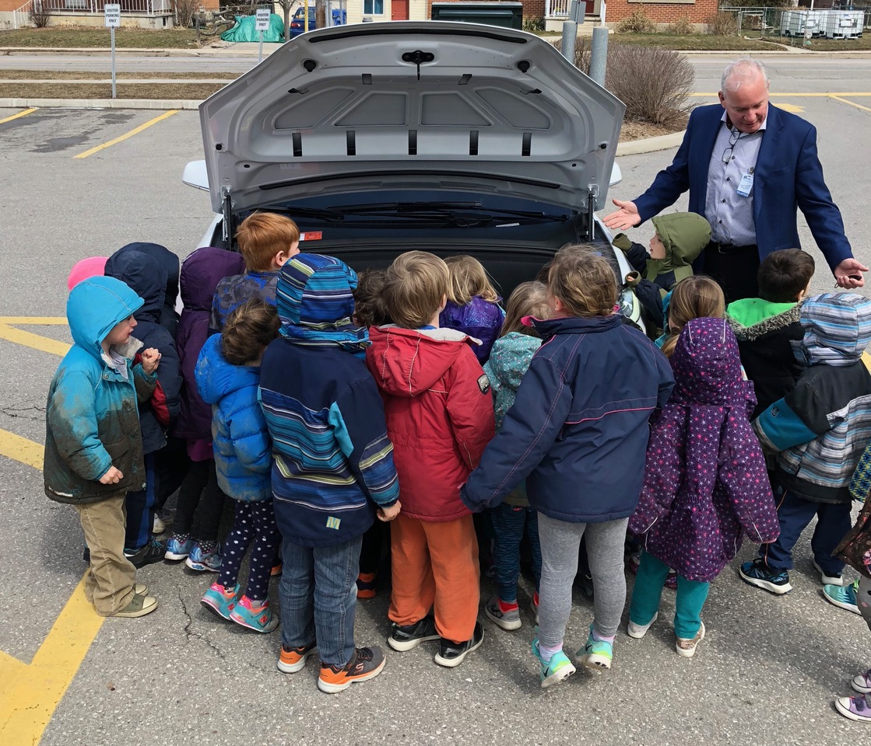

Slide 39
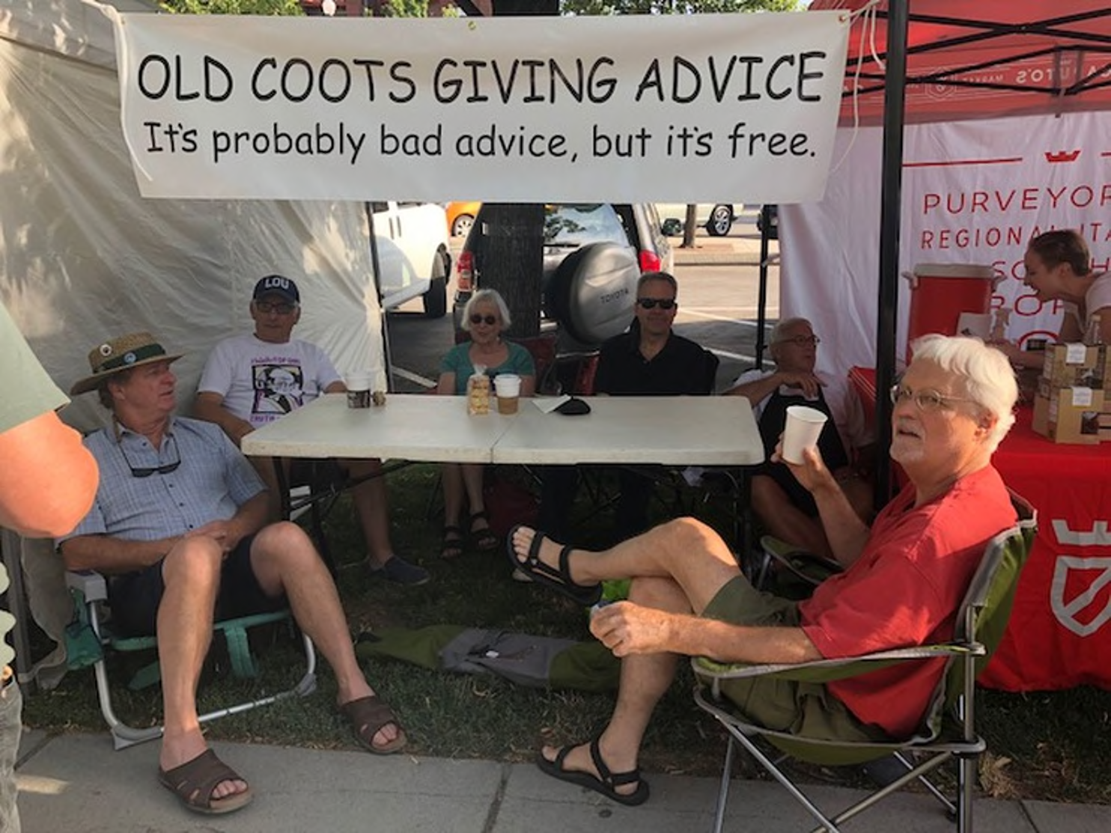

Slide 40
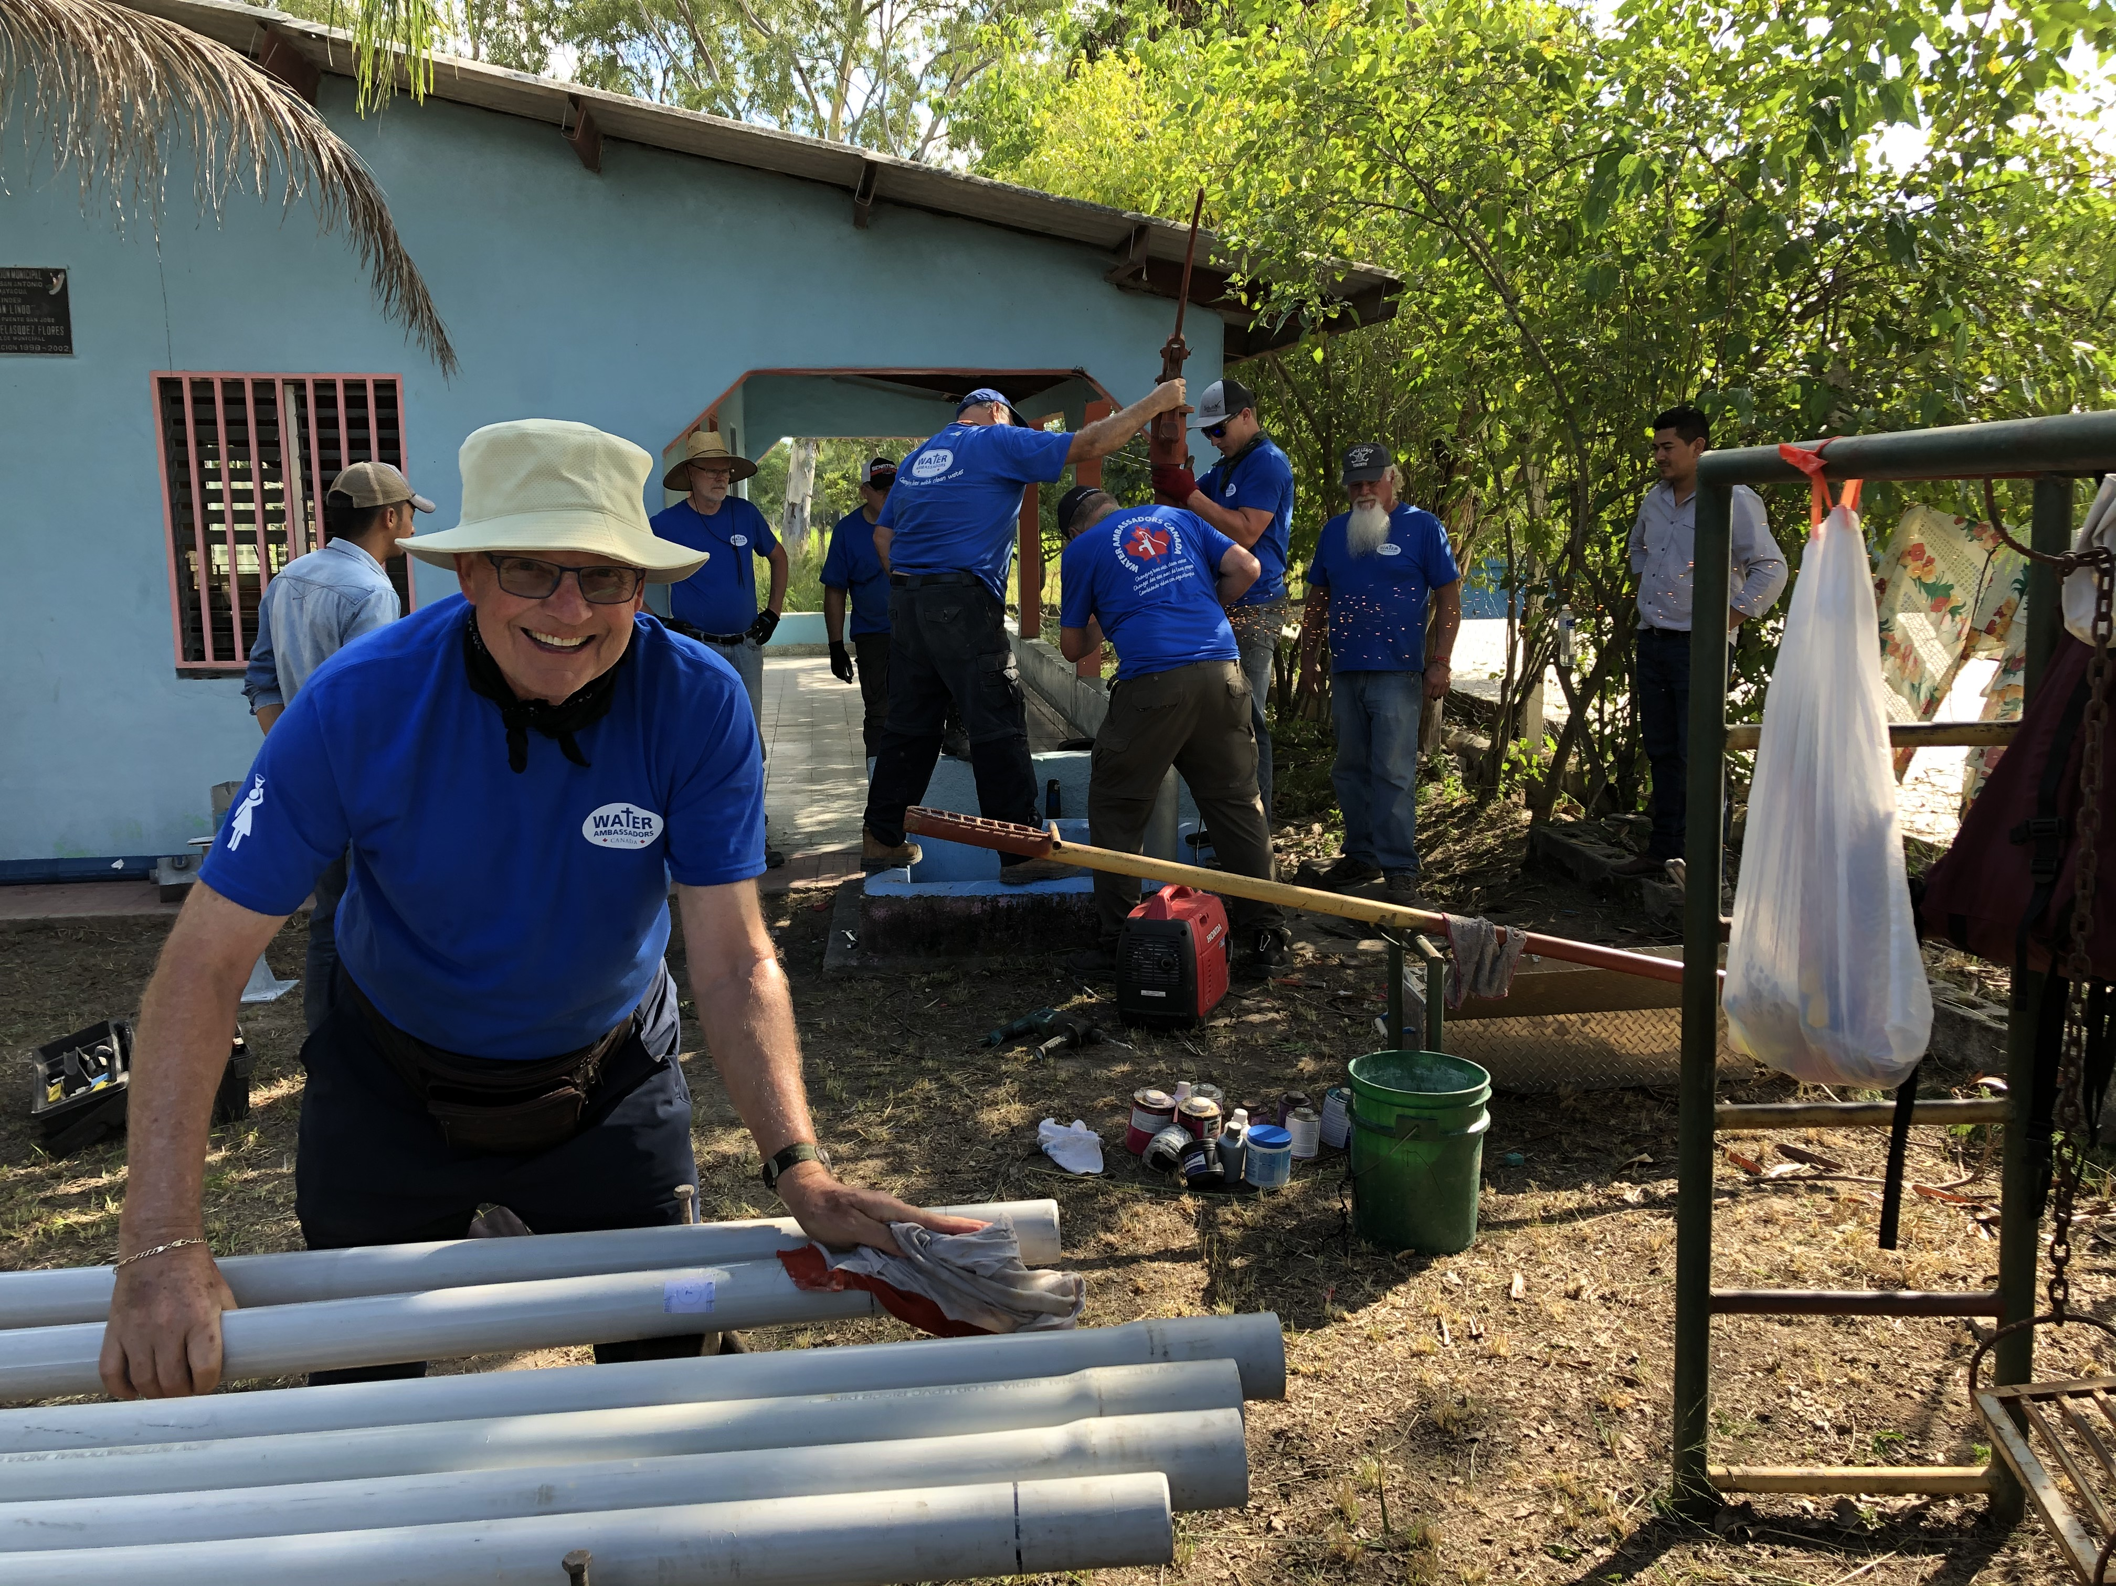
Notes:
OR MAYBE IT'S DOING WHAT I DID...
WAC -- HONDURAS
7 WELL REPAIRS IN 5 DAYS
CLEAN DRINKING WATER TO OVER 2200 PEOPLE
HYGIENE TRAINING TO 300 MORE

Slide 41

Contaminated water is the world’s biggest cause of death and disease, and is the easiest to fix.
waterambassadorscanada.org
water45678
TEXT:
Notes:
MAYBE YOU'D LIKE TO GET INVOLVED WITH US

Slide 42
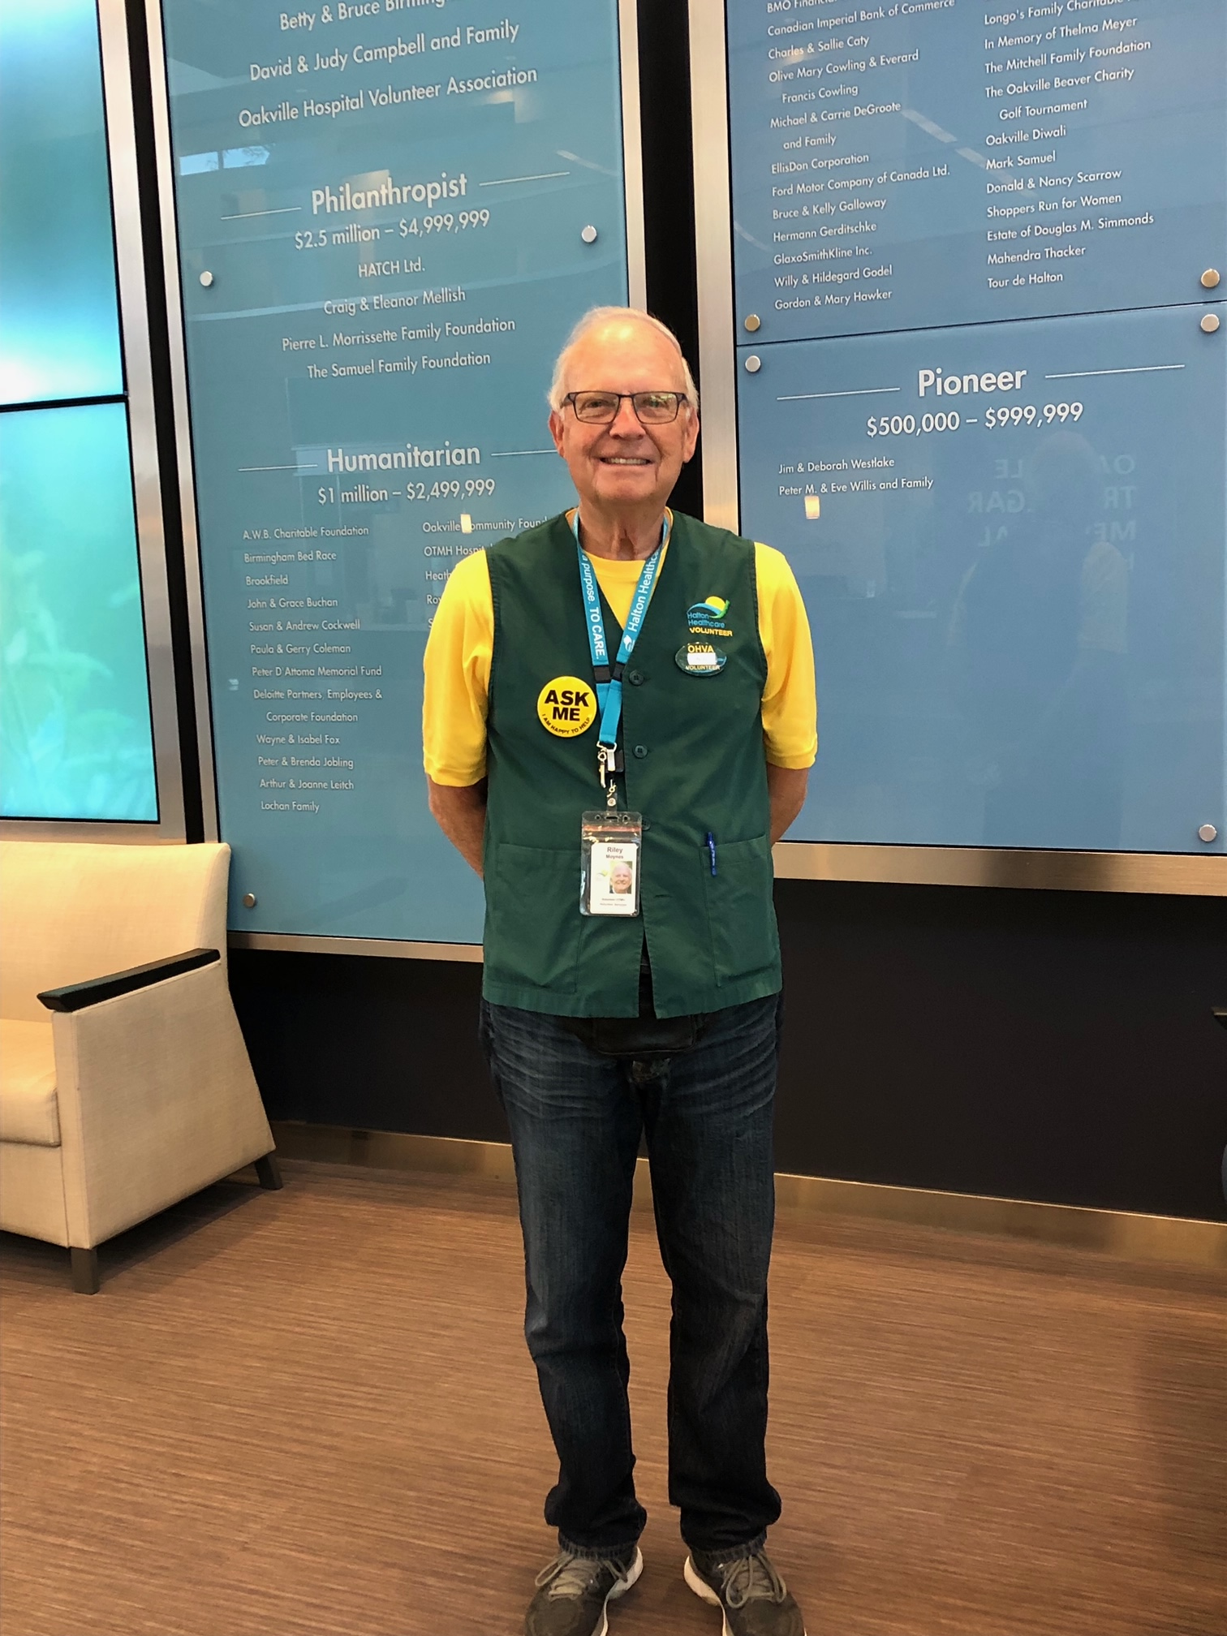

Slide 43
The only really happy people are those who have learned how to serve.
Rick Warren
Author of: The Purpose-Driven Life
What on Earth Am I Here For?

Slide 44
REMEMBER…
You are not alone in this transition.
You have more options to consider, and longer to do it than ever before.
You have a huge opportunity to combine your passions and your strengths to make the world a better place.

Slide 45
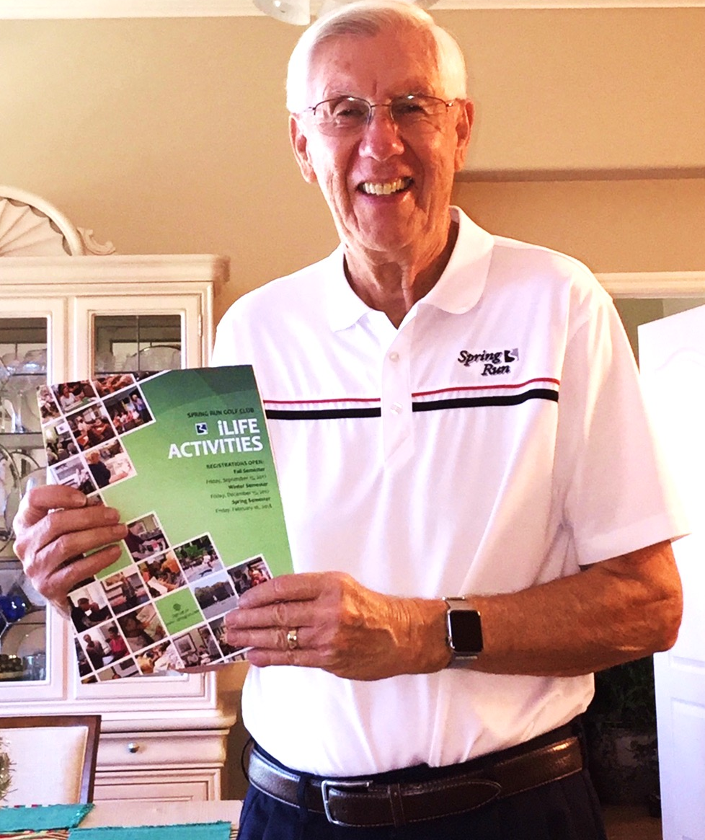
Notes:
FURTWENGLER STORY/ LIFE BEYOND GOLF
YEAR 1 9 PROGRAMS/ 200
NEXT YEAR 45 PROGRAMS/ 700
NEXT YEAR OVER 90 PROGRAMS/ 2,100 REGISTRATIONS

Slide 46
AND WHEN YOU DO you will discover you have…
a new STRUCTURE for your life
a new IDENTITY, connected to your passion
new RELATIONSHIPS
renewed PURPOSE
a sense of enhanced POWER to make good things happen
That’s Phase #4!
Notes:
REMEMBER THE FIVE LOSSES IN PHASE 2 ??
ALL REGAINED AND ENHANCED IN PHASE 4
THIS IS THE MAGIC OF PHASE FOUR!!

Slide 47
IN REVIEW
You now know the Four Phases of Retirement.
If you’re retired, you know what Phase you’re in.
If you’re not, you know what to expect when the time comes.

Slide 48
Don’t retire…
Rewire!
Notes:
DON'T RETIRE...
REWIRE!

Slide 49
Everyone says you have to get ready to retire financially.
Of course you do, but what they don’t tell you is that you have to get ready psychologically.
Notes:
SO...
*ENJOY YOUR VACATION INPHASE ONE
*BE PREPARED...FOR THE LOSSES OF PHASE TWO
*EXPERIMENT AND TRY MANY OPTIONS IN PHASE THREE
*AND 'SQUEEZE ALL THE JUICE' OUT OF PHASE FOUR!

Slide 50


Ready to take your retirement to the next level?
Revisit today’s' message in my TEDx Surrey talk on YouTube, now with over 5 million views…and counting!
The 4 phases of retirement | Dr. Riley Moynes

