Slide 1
Navigating Complexity: Strategies for Success​
Notes:
Hello / bonjour & Introduction.
Before I begin, I want to recognize the traditional, unceded territory of the Algonquin Anishnaabe on which we find ourselves today. Je reconnais que je me trouve sur le territoire traditionnel non cédé du peuple algonquin Anishinaabe. Je suis très reconnaissant d'être sur cette belle terre et de profiter du privilège qui vient d'être ici.
[Online: It has taken all of use some getting used to the online course. I promise you – It can be a lot of fun if you jump in, speak up, engage with me and your colleagues. Use the raise hand function, the chat, the emojis. Whatever works for you. I am going to ask XX to watch the chat/ screen for me as well, in case I miss something. Would invite you to do the same. ]
There is only so much on my slides to teach you – the rest comes from you. That is especially true for this subject – which is all about your context, your reality.
Very important to me that we create a safe space here. What is said in the room, stays in the room; at the same time, have fun / lean in / be honest. Listen for the good intention – work past your first reaction, if you happen to hear something you disagree with.
On va presenter les diapos en Francais et Anglais – I will speak to them, variously, in both languages. Je vous invite de suivre et de poser vos question dans le langue de votre choix.

Slide 2

Objective
Explore how to lead effectively in complex and evolving environments.
Discuss how uncertainty and shifting conditions impact you and your teams, and recognize patterns that influence transitions.
Identify key actions that drive results and ensure success in uncertain or shifting contexts.
Notes:
Photo Adobe Stock Nous allons examine trois objectifs d’apprentissage aujourd’hui:
Définir les avantages d’aller au-delà la gestion du changement vers une approche de leadership en matière de changement.
Appliquer un modèle de transition qui permet de venir à bout des résistances et de saisir les occasions qui se présentent.
Élaborer un plan d’action qui tient compte des éléments clés d’un changement réussi pour gagner en efficacité.
Comme je viens de dire en Anglais -- votre participation active sera importante pour donner vie à ce matériel, le rendre pertinent en fonction de vos besoins et finalement améliorer votre apprentissage.
#372900114

Slide 3
We live in increasingly challenging times…
V
U
C
A
Volatility.
Uncertainty.
Complexity.
Ambiguity.
Notes:
Who has heard of the VUCA concept before? Define it for us?
VUCA is a concept introduced in the 1980s by the US Army War college to describe a complex, multilateral world. It was used more frequently in the 2000s and certainly describes the challenging environment in which we currently operate.
VUCA provides a framework for management team introspection, foresight (or contextual intelligence), strategy, and proactive adaptation.
But is also speaks to how all of us – including our teams - experience this current point in time.
It stands for “volatility, uncertainty, complexity and ambiguity – ou, en francais, “volatilite, incertitude, complexite, et ambiguite.
Volatility – refers to the amount of uncertainty about the size of the changes or challenges, the turbulence and the pace of change.
Uncertainty - refer to our ability or inability to predict the future.
Complexity – refers to the number of variables and the relationships between them that we need to take into account. Some say the “C” stands for chaos – a even more pejorative label.
Ambiguity – refers to the lack of clarity about causal relationships. This can occur due to incomplete, contradicting, inaccurate information.

Slide 4











…with many dynamic issues at play.
AI and Rapid Technological Development.
Unfiltered, Real-Time Communications.
Changing Nature of Work and Demographics.
Distributed Authority.
Inequality and Social Unrest.
Big Data.
Economic Instability and Rising Debt.
Global Health Crises.
Geopolitical Destabilization.
Environment and Climate Change.
Notes:
These are some of the external factors that are leading to change in the world – sometimes with amazing rapidity. Voici une liste de facteurs -- pas du tout complet mais quand même intimidant.
Some have called the situation we are living in the “polycrisis”, recognizing that these factors are increasingly interconnected, that they converge and amplify each other – making their resolution that much more challenging.
As public servants, to continue to offer that premise of stability and authority that government is built on – while all the while managing these disruptions. That is hard / ceci est difficil
On top of this, I suspect that a lot of the change preoccupying you at the moment is internal – related to return to office, “refocusing government spending” exercises, the possibility of an election here – and our role in responding to what is happening as a result of elections South of us.
It strikes me that you are both experiencing change yourselves and, sometimes, seen as the agents of change. That dual role can be hard.
I want to pause here a minute and invite you to tell me a little more about what is going on for you – or for your team.
Additional thoughts:
Reflect on “factors beyond our control”. For many us, especially in executive positions, control is one of the ways we deal with stress. And as public servants – we may, directly or indirectly, feel we should some influence over these particularly complex issues. But of course – that influence is minimal. Like every one else, we need to accept them and their impact -- factor them into our leadership, our strategic and operating environments.

Slide 5
The Antidotes
V
Volatility.
Vision.
U
Uncertainty.
Understanding.
C
Complexity.
Clarity.
A
Agility.
Ambiguity.
Notes:
Successfully leading change requires us to acknowledge VUCA, and to implement antidotes to VUCA – which are vision, understanding, clarity and agility.
For instance, in the face of volatility -- a clear and guiding vision helps us make sense of what we are experiencing. Relates to a very human tendency to use storytelling, narrative to make sense of the world. Pervasive in human culture.
The antidote to uncertainty is understanding – explains the need that people have for information, transparency and facts.
Clarity helps with complexity – recognizing that sometimes it only comes to us in bite sized pieces.
Finally, the antidote to ambiguity is agility - recognizing the need to respond and react quickly to changes we cannot fully forsee.
Helpful concepts to keep in mind – whether it is in the solutions you put forward or your relationships with those you manage, including yourself ☺.
They are also what underlies good change leadership – as opposed to change management.

Slide 6

Change Effectiveness
Effectiveness is equal to the quality (Q) of the solution times the acceptance (A) of the solution.
E = Q x A.
Notes:
Ceci est une autre facon de dire la meme chose. Change effectiveness is equal to the Quality of the solution times the Acceptance of the solution.
When we refer to the ‘quality’ of the solution, we’re usually talking about the quality of the technical side of the change, the new ‘thing’, ‘organization’, ‘process’ or ‘technology’ that we are implementing.
When we refer to the ‘acceptance’ of the solution, we're talking about the acceptance of or engagement with the solution.
Since the change itself is often more tangible and measurable than acceptance, people tend to spend most of their time trying to improve the quality of the solution and in general, managing this side of change.
And sometimes they are less attentive to the people part, to their detriment.
In order for change to be effective, you need to bring people along. That simple.

Slide 7
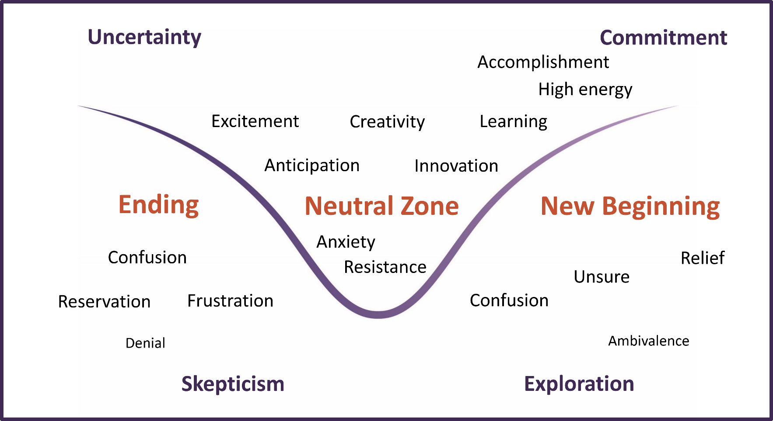
How People Experience Change
The three stages:
Ending.
Neutral Zone.
New Beginning.
Notes:
Bringing people along means acknowledging the necessary psychological process that we go through as we adapt to change that is imposed on us. There are a few models that attempt to capture this process.
Bridges Transition model. Like a story, it has a beginning, a middle and an end -- but here the ending is the beginning, and the new beginning is the end – and each stage is associated with different emotions. The flow is from uncertainty and skepticism to commitment and then exploration / opportunity.
Sometimes same emotion is in different stages, we all process and experience things differently.
People within a group will move through the transition process at different paces. Not linear – jump forward, then back. Sometimes different stages depending on different aspects of the change.
Sometimes this difference in timing is predictable – executives often hear about re-orgs before everyone else – but sometimes it is idiosyncratic, just more attached to old ways than others.
Another model that is sometimes used is the Lewin model, based on ice - unfreeze, change, refreeze.
By understanding the dynamics of transition we can help people to move through it more effectively and, in particular, lead them to see opportunity as opposed to loss. To so so, however, be curious and practice empathy -- Will get you a better sense of the problem, what to do about it.
In so doing, however, you need to be very cautious about making assumptions and jumping to conclusions about which stage a person is in based on the emotions you think that person is experiencing. You have to use what we sometimes call 110% listening. Many people would prefer to avoid talking honestly about emotions in a work to begin with. In the face of stress, we are even more likely to turtle and hide what we are really feeling.

Slide 8

How People Experience Change: The Brain in Distress
When faced with stress or a threat, the conscious brain conserves energy, leaving the unconscious in charge of decision-making.
When conserving energy emotion and survival instincts kick in: fight, flight, freeze (and tend, befriend).
When regulated and psychologically safe, we have access to high level functioning and empathy.
Notes:
Face au stress, le cerveau conscient conserve son énergie, laissant les processus inconscients prendre les décisions. Lorsque l'énergie est conservée, les émotions et l'instinct de survie entrent en jeu.
In English, we talk about the reptilian brain or survival instinct taking over – fight, flight or freeze in the face of a threat. To this, the psychologist Shelly Taylor would add, for women in particular, the tendency to tend and befriend in the face of stress – a natural instinct to do whatever it takes to secure the group’s support. This can be both effective and ineffective, depending on how selfless the tendency is.
As anyone with stage fright knows, you do not have to be physically in danger for the brain to act this way. Change – and whatever loss that might be perceived to include – also provokes this reaction.
And in this state, we are not naturally inclined to think as rationally or as empathetically.
We might also find ourselves easing into easy biases – like seeking out those who are like us, for comfort and because we trust them more readily. While comforting, this can further impede our capacity to weather the change – as well as our capacity to lead it.

Slide 9

What Is at Risk?
Influence.
Status.
Relationships.
Memberships.
Meaningful work.
Control of destiny.
Notes:
Photo Adobe Stock
#42840039
When we are under threat, our mind tends to go to the losses……This is a well documented psychological phenomenon. Daniel Kahneman and Amos Tversky developed prospect theory, which shows that people perceive potential losses as more psychologically impactful than equivalent gains –a loss of 100$ feels more painful than a gain of $100 feels pleasurable. Studies on loss aversion estimate that losses are psychologically twice as powerful as equivalent gains. Especially true under stress /uncertainty,
Those losses can be very different depending on the individual, even if on the face they are experiencing the same change. One person on a team that is being restructured might be worried about losing close work friends, another their influence with their boss.
As Peter Senge (sengeee), a thought leader in systems thinking, says, “People don’t resist change. They resist being changed!”.
This resentment / resistance can look like bad performance and generate even more problems. Can look like : Being overly critical / Sarcastic remarks / Missed meetings, missed deadlines, failed commitments / Sabotage / Quiet/Passive-aggression
La plupart des gens n’aiment pas qu’on leur impose un changement et ils peuvent se sentir menacés, surtout lorsqu’ils ne savent pas exactement quelles seront les répercussions du changement. En votre qualité de leaders, il vous sera utile de comprendre de quoi il s’agit.
This list is not exhaustive –but it can be helpful. When you reflected on your bad change experience, were any of these in play? Are any of these in play now for you or team? Est-ce que tous les employés dans votre equipe subissent la même « perte »? Are there other losses that are not captured here?

Slide 10
What Is There to Gain?
Influence.
Status.
Relationships.
Memberships.
Meaningful work.
Control of destiny.
Notes:
Photo Adobe Stock
#42840039
This is exactly the same slide – but with a different title or mindset ☺.
One of the challenges in processing change is to shift the mindset from loss to gain – Again, is always easier to stay where we are than to risk what we don’t know and haven’t experienced.
L’une des choses que vous pouvez faire en tant que leader est d’aider vos employés à passer de la perte au gain – avec des avantages dans de nombreux domaines où ils avaient auparavant constaté des pertes. C’est ce que fait un bon leadership en matière de changement.

Slide 11

Resistance
“I don’t get it.”
“I don’t like it.”
“I don’t like you.”
– Rick Maurer, Beyond the Wall of Resistance
Notes:
Photo Adobe Stock
#71586916
Imagine that you’re out enjoying the afternoon in a sailboat - the wind picks up and serious storm clouds roll in. What do you do? To keep it simple, let’s say you have two options: 1. Hoist the sails and try to make it home or 2. Drop anchor and stay put until the worst of the storm passes.
This is a metaphor for how some people respond to the challenge of change. At the extremes, there will be people who lean in and engage immediately, using everything at their disposal trying to make it work and there are others who will ‘drop anchor’, and resist any external pressure to move.
Dans les deux cas, les gens choisissent l’option qui leur semble la plus sûre à ce moment-là. This is true even though the choices and behaviours themselves are very different. People don’t always see that they are doing as resistance, they often see it as survival.
We ourselves also sometimes have our own resistance to seeing and addressing resistance of our team because of a lack of confidence in our ability to deal with it. We need to listen carefully – fight our own biases and assumptions. Consider what we know about the resistance – and especially why we know it or we think we know it. What you heard? From them? From others? Their behaviour?
Many ways to get at what you need to hear – and we all have our skills in this area. For many teams, it help to book time to simply listen. Avoid the temptation to frame the discussion. Rather, ask simply what people are experiencing and what they need. Listen without defending, justifying, or trying to change opinions. Be careful about when you speak – if you go first, may influence what comes next. BUT, if people are quiet – may need to show your own vulnerability.
In listening, you will get a better sense of what they are resisting. To use a lexicon developed by Rick Maurer, is it because they don’t get it, they don’t like it or they I don’t like you?

Slide 12

“I don’t get it.”
This is a form of cognitive resistance. It is about information.
What you can do:
Share data and information.
Use plain language.
Try different communication channels.
Be consistent and committed.
Notes:
Photo Adobe Stock – Generated by AI
#920786585
So the first of these – I don’t get it.
In the case of “I don’t get it”, there is a lack of understanding about the need to change or what the change is, exactly. This is a level of resistance that may be addressed by presenting information, facts and data.
Lorsqu’il s’agit d’une résistance de type « je ne comprends pas », il y a un manque de compréhension soit de la nécessité du changement, soit de la nature exacte du changement – souvent, franchement, de l’urgence du changement. Cela est particulièrement vrai lorsqu’il y a beaucoup de changements en même temps.
The key here is to make sure that you are communicating effectively. Corporate environment tends towards the email, the briefing note, the powerpoint. This are not likely the best ways to communicate – and certainly not the only ways. There no one size works for all here. You need to recognize that people learn/absorb information best through different channels, at different paces and under different circumstances.
Try to avoid overcommunicating nothing at all – this causes cynicism. But, also do not say nothing at all until you know everything - Hard to engage when you are in the dark yourself, better to be honest
These discussions can be difficult when we ourselves have an imperfect understanding of the change and can’t answer questions as clearly as we would like. We may feel a sort of cognitive dissonance – saying one thing, but perhaps believing another.
If the problem truly is a lack of understanding, information can help – remember the VUCA antidotes, vision and understanding help address volatility and uncertainty. Sometimes, however, the problem is actually a higher level of resistance masquerading as “I don’t get it” because it feels safer to admit this than the other two.
Questions: What has made this kind of resistance difficult to address for you? What strategies have you used to address this type of resistance?

Slide 13

“I don’t like it.”
This is a form of emotional resistance. It is an emotional reaction.
What you can do:
Listen and show empathy.
Explain what’s in it for them.
Engage people in the process.
Practice truth and transparency.
Help name emotions.
Notes:
Photo Adobe Stock – Generated by AI
#920786585
I don’t like it » – an emotional reaction, along the lines of the stress responses we saw earlier. Your job here is to understand what people are feeling and to try to smooth that emotional resistance.
Que-ce que vous pouvez faire?
Écoutez et faites preuve d’empathie.
Expliquez-leur ce que cela leur apporte.
Mobilisez les personnes dans le processus.
Dites la vérité et soyez transparente – faites preuve d’honnêteté sur ce qui est – et n’est pas.
Be attentive to HOW they need you to listen. Do they just need the listening -- Are they looking for compassion? Do they want your help with solutions? Ear / heart / head.
Questions: Quand avez-vous rencontré de la résistance de type « je n’aime pas ça »? Qu’est-ce que vous vouliez ou de quoi aviez-vous besoin? Qu’est-ce qui aurait pu vous aider dans cette situation?

Slide 14

“I don’t like you.”
This is a form of distrust. It may be about you or what you represent.
What you can do:
Work on building and repairing relationships.
Build psychological safety.
Address underlying conflicts.
Notes:
Photo Adobe Stock – Generated by AI
#920786585
Unlike the other two types of resistance to change, in the case of “I don’t like you”, the resistance is not about the change itself. This type of resistance may be personal. In some cases, those resisting may not like you, or maybe they do like you but don’t have trust or confidence in you as a leader.
In other cases, it’s not you, it’s the role you are in or the organization you are from ex. head office – or the corporate services branch or DMO..
IMPORTANT for your own resilience to not mistaken dislike of your role for dislike of you.
Face à ce type de résistance, il peut s’avérer utile d’utiliser vos compétences en matière d’intelligence émotionnelle et d’adopter une approche de leadership compatissante. Il y a peut-être des mesures que vous pouvez prendre pour renforcer la confiance.
TRUST is a huge factor in managing change and restoring it can be vital – not just to support employees but also to ensure that you get the reflections / feedback you need from them to manage the change effectively.
Question: Quand avez-vous rencontré de la résistance de type « je ne t’aime pas toi » - comme employe ou comme gestionnaire? Ou bien ce manque de confiance envers la personne qui transmettait le message du changement ou envers les personnes qu’elle représentait?
Qu’est-ce que vous avez faites? Que aurait pu vous aider dans cette situation?

Slide 15

Don’t Forget Yourself
When you are implementing change—you are also managing through it yourself.
Check your own mindset and resistance. What do you need?
Give yourself the same grace and kindness that you give others.
Notes:
Photo Adobe Stock – Generated with AI
#1080527204
Before we break into small groups – want to end on a very important point: don’t forget yourself in all this. It has been said already, you are not only leading change – you are also living the change and are therefore going through all of the same things yourself.
You need to take care of yourself, check in with yourself, give yourself the same grace and kindness and understanding you give others.
There will also be things you are concerned about and changes you are resisting. There are also opportunities that you might not see if you are in a certain mindset.
Il y aura également des choses qui vous préoccupent et des changements auxquels vous résisterez. Il existe également des opportunités que vous ne verrez peut-être pas si vous êtes dans un certain état d’esprit.
This is for your sake – but equally for the sake of those you manage. Like being on a plane with kids, you need to put on your own air mask first! I cannot reinforce this one enough.

Slide 16

Summary
Highlight how adapting to shifting conditions can strengthen your impact on your team and outcomes.
Apply a transition model that allows you to overcome resistance and better seize opportunities that arise.
Identify actions that take into account the key elements of successful change.
Notes:
Photo Adobe Stock
#372900114

Slide 17
Table discussion ​
What is one small, realistic action you could take tomorrow to strengthen psychological safety during transitions?​
​
How do you check your mindset during difficult change to ensure you’re showing up at your best?​
​
Which emerging forces (AI, demographics, distributed authority, social pressures, etc.) are most shaping your leadership reality this year?
Notes:
Photo Adobe Stock
#71586916
Imagine that you’re out enjoying the afternoon in a sailboat - the wind picks up and serious storm clouds roll in. What do you do? To keep it simple, let’s say you have two options: 1. Hoist the sails and try to make it home or 2. Drop anchor and stay put until the worst of the storm passes.
This is a metaphor for how some people respond to the challenge of change. At the extremes, there will be people who lean in and engage immediately, using everything at their disposal trying to make it work and there are others who will ‘drop anchor’, and resist any external pressure to move.
Dans les deux cas, les gens choisissent l’option qui leur semble la plus sûre à ce moment-là. This is true even though the choices and behaviours themselves are very different. People don’t always see that they are doing as resistance, they often see it as survival.
We ourselves also sometimes have our own resistance to seeing and addressing resistance of our team because of a lack of confidence in our ability to deal with it. We need to listen carefully – fight our own biases and assumptions. Consider what we know about the resistance – and especially why we know it or we think we know it. What you heard? From them? From others? Their behaviour?
Many ways to get at what you need to hear – and we all have our skills in this area. For many teams, it help to book time to simply listen. Avoid the temptation to frame the discussion. Rather, ask simply what people are experiencing and what they need. Listen without defending, justifying, or trying to change opinions. Be careful about when you speak – if you go first, may influence what comes next. BUT, if people are quiet – may need to show your own vulnerability.
In listening, you will get a better sense of what they are resisting. To use a lexicon developed by Rick Maurer, is it because they don’t get it, they don’t like it or they I don’t like you?

Slide 18

Stay connected
canada.ca/school-ecole
@School_GC | @Ecole_GC
18

Slide 19
Resources
19

Slide 20




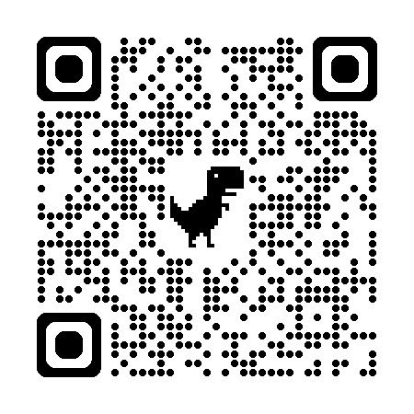

Additional Resources
Online self-paced courses.
Toolkits.
Evidence-Informed Decision-Making: Facts, Values, and the Scientific Method (TRN502)
Thrive Team Toolkit (TRN4-J38)
Toolkit for Virtual and Hybrid Teams (TRN2-J05) .
Making Change Stick (TRN448).
Virtual classroom courses.
Books.
Leading Change in an Unpredictable World (TRN412)
John Kotter, Leading Change
Human-Centred Leadership in a Hybrid Workplace (TRN416)
Robert Kegan and Lisa Laskow Lahey, Immunity to Change
Thrive Classroom Series (TRN130, TRN131, TRN132) .
CSPS Programs
Job aids.
New Directors Program
Using the VUCA Approach (TRN4-J04)
Aspiring Directors Program
Using the Cynefin Framework to Excel as a Leader (TRN4-J03)
Orientation for Directors General
Workbook for Preparing to Lead Change Effectively (TRN4-J50).

