Slide 1
Unlock the Power of HR & Pay Tools: A Special Executive Session
Digital Solutions (DS)
Office of the Chief Human Resources Officer (OCHRO)
December 11, 2025

Slide 2
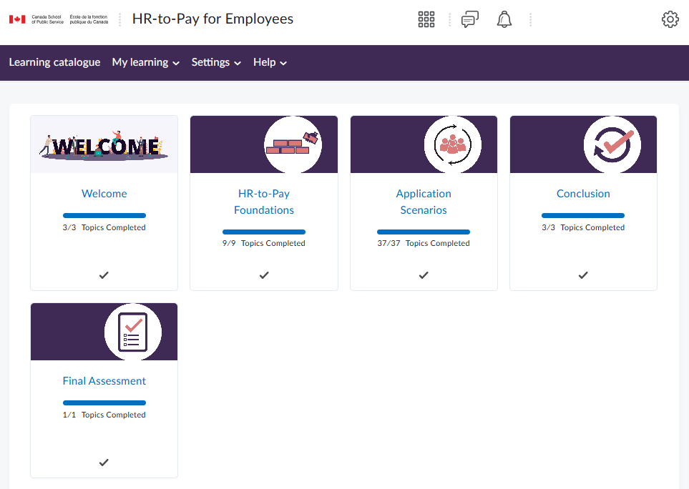


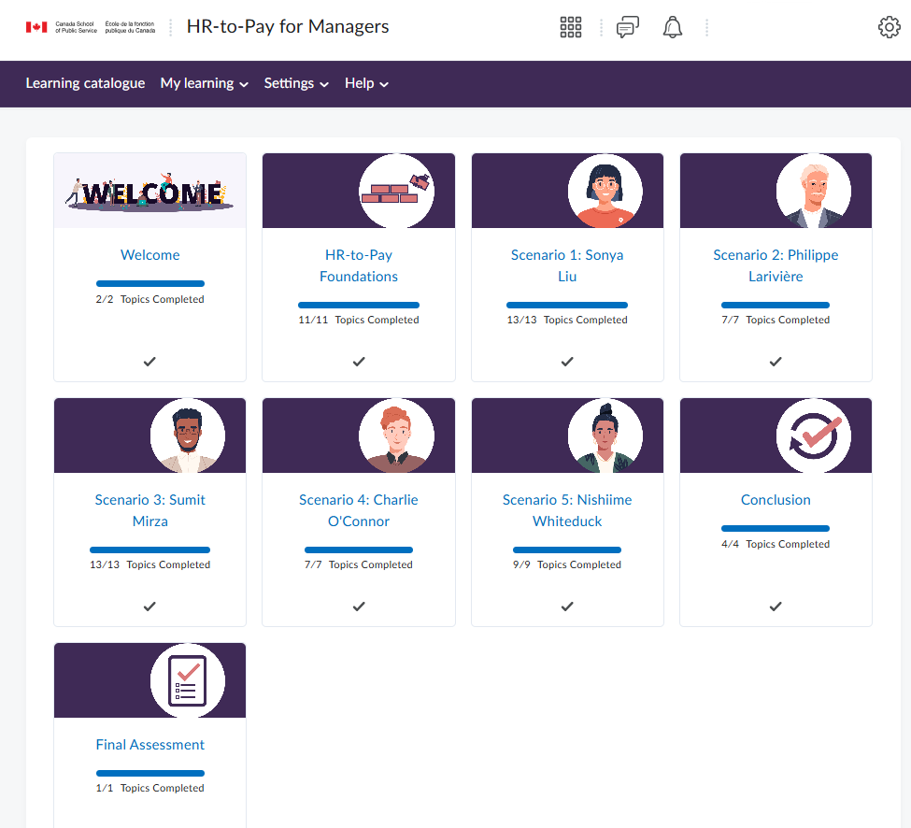
Purpose of the Session
Increase awareness of the tools available to support managers, employees and with their HR and pay responsibilities.
Updated mandatory HR and pay training (demo)
HR and Pay Learning Community site on GCXchange (demo)

Slide 3







Why this training matters!
More than 345,000 unapproved transactions*
$495M in overpayment arrears**
More than 115,000 employees are in an overpayment situation**
Acting, acting extensions and promotions are among those with the highest rate of untimely submission***
Untimely submission/ approval
Errors and omissions
Manual intervention
Financial hardship
Lost developmental or career opportunities
Loss of trust
Notes:
*Time and Labour Report (December 2025)
**Salary Overpayments Dashboard (November 2025)
***Timeliness Report (October 2025)

Slide 4
Background
With PSPC and departments, assess training needs and develop training plan to clarify roles and responsibilities within HR-to-Pay process.
Update training as needed and assess its effectiveness.
OAG recommendation (2018)
COR137 launch
(March 2024)
FON308 launch
(February 2025)
Design and development
OAG recommendation closed
(September 2024)
TB Mandatory Training Inventory update
Comms to DHs, HHR, learning coordinators
Lessons learned
NOTE: COR137 is now referenced in the Authority Delegation Training
Collaboration with PSPC and CSPS
Environmental scans
Extensive consultations with more than 400 managers and SMEs from 30 organizations
19 early adopter depts/agencies for COR137
Feedback and testing
TB Mandatory Training Inventory update
Continuous updates and enhancements to both courses.

Slide 5
Demo of HR-to-Pay for Managers (COR137)

Slide 6
HR-to-Pay for Managers (COR137) – Learner Feedback
Approx. 15K completions out of 22K registrations
Overall satisfaction
86%
Relevant
to job
89%
Valuable use of time
85%
Knowledge improved from 7 to 9/10
“Very useful and thorough training”
Need “more examples” and “how to”
Data as of September 30, 2025

Slide 7
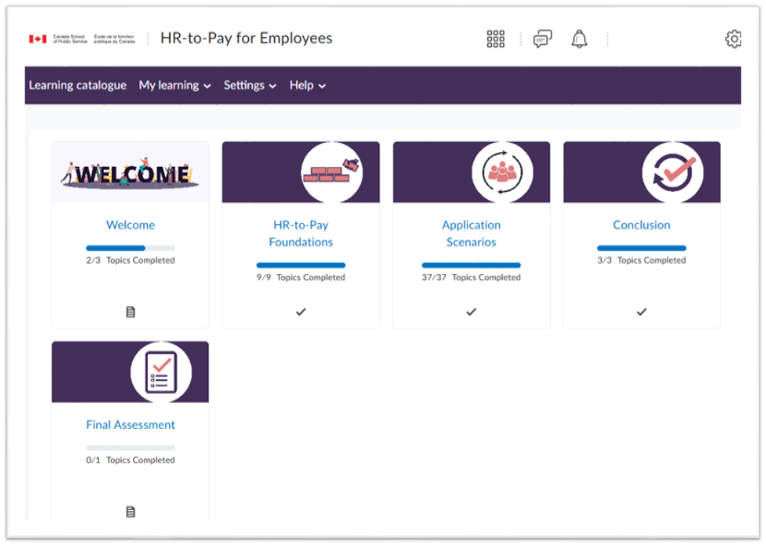
Demo of HR-to-Pay for Employees (FON308)

Slide 8
HR-to-Pay for Employees (FON308) – Learner Feedback
Approx. 60K completions out of 68K registrations
Overall satisfaction
84%
Relevant
to job
84%
Valuable use of time
80%
Knowledge improved
from 6 to 9/10
“I can navigate HR-to-pay more confidently now.”
“need a how to … with processes and instructions”
Data as of September 30, 2025

Slide 9
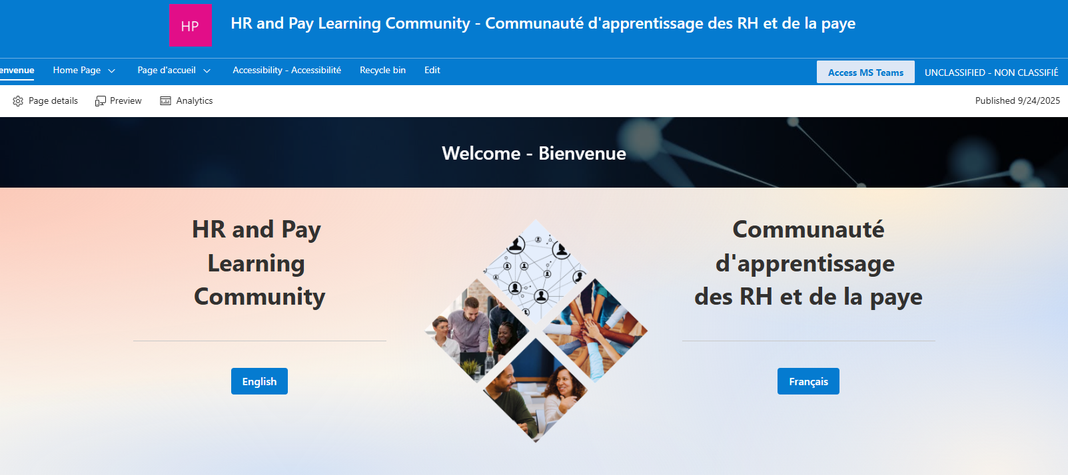
Demo of HR and Pay Learning Community - GCXchange

Slide 10



Next Steps
Increase uptake
Update and enhance (ongoing)
Assess impacts
Roadshow for Regional National Managers’ Communities
Departments and agencies
HR Council
APEX
Assoc. of Compensation Managers
Post-course assessment of changes in learner behaviour
Course registration statistics
Learner feedback
Manager focus groups
Reflect changes to policies and best practices
Enhance the content to meet evolving learners needs.

Slide 11



What you can do…
Encourage others to check out the training
Share insights from today’s session
Provide your feedback – it matters!
​
  10 questions​
  Anonymous and confidential​
  Approximately 4 minutes to complete​
  ​
  HR and Pay Engagement Sessions ​
  Note: complete in the language of your choice​

Slide 12

Questions and Answers
Contact us: HRtoPayTraining-FormationRHaPaye@tbs-sct.gc.ca

