Slide 1

BETTER ACCOMMODATION PROJECT
Driving Change Based on Project Learnings

Slide 2
Accessibility
This presentation has been prepared using the Digital Accessibility Toolkit.
If you experience any barriers to accessing this document, please contact us at ESDC.BAP-PAMA.EDSC@hrsdc-rhdcc.gc.ca.

Slide 3
Objectives
To take stock of the Better Accommodation Project (BAP)
To present key findings of the sludge audits on the prototypes and an overview of the Meta-Sludge Audit Report
To present an overview of accommodation services toolkits
To discuss how you can help drive change

Slide 4
BAP Remains Relevant in the Current Context
BAP is being delivered during a time of intense focus on efficiency, effectiveness and productivity and it directly responds to these priorities. The system impact is real, the cost of inaction is high and we can’t afford to lose momentum. BAP:
drives productivity and efficiency by streamlining the workplace accommodation service delivery model to reduce cost;
reinforces commitments under the Accessible Canada Act, helping departments identify, remove, and prevent barriers to inclusion; and
supports a workforce that reflects the diversity of Canadians it serves.
The Office of the Auditor General Canada is conducting an audit of recruitment, promotion and retention of employees with disabilities.
BAP toolkits contribute to success of employees with disabilities.
If we don't continue this work, we stand to lose significant opportunities:
to leverage learnings and insights already gained through BAP;
to advance internal service delivery that is more consistent and cost-effective; and
to strengthen employee trust, productivity and retention.

Slide 5
Our Journey Towards 2040
Vision:
A barrier-free Canada, including the most accessible and inclusive public service in the world
BAP
Build on progress by testing and sharing learnings
Post-BAP
Some key improvements with ACA, but systemic barriers remain; largely Medical Model
Pre-BAP
Implement key success factors in accommodations and embed Social Model
Enhance understanding of key success factors and behaviours

Slide 6
The BAP Vision
Best-in-class workplace accommodation for employees with disabilities that reflects the social model of disability, is timely, consistent, inclusive and responsive, and enables all federal employees with disabilities to receive supports to fully participate in the workplace, regardless of where they work.
BAP Approach: Evidence-Based, Deliberate, Innovative & Impactful​
1) Service Model Review (Key success factors at Organizational Level)
2) Behavioural Science Validation
(Behaviour-Informed Sludge Audits)
As organizations put in place Key Success Factors, employee accommodation outcomes improve over time.
6

Slide 7
In one short year…
We brought nine departments together to learn, work and innovate collectively, undergoing a shared process that surfaced consistent, enterprise-wide findings.
Partner departments worked with the BAP team and Privy Council Office’s Impact and Innovation Unit to conduct ‘sludge audits’ (reviews that identify pain points in the accommodation process) and prototype solutions to address the ‘sludge’. These findings were then consolidated into a meta sludge audit report.
Using robust behavioural science methodology, we gained a deeper understanding of a known critical gap affecting employees with disabilities.
We leveraged and built upon Government of Canada expertise and previous initiatives, turning insights into action.
We identified key barriers in workplace accommodation and translated insights from literature reviews, qualitative engagement and sludge audits into practical, scalable tools.

Slide 8
Service Delivery Learnings
Meta-Sludge Audit Report - Preview of Key Findings
While the Treasury Board Secretariat's Directive on the Duty to Accommodate (DTA) guides us all, departments operationalize it differently. All face similar delivery challenges linked to inefficient, administratively burdensome and risk averse processes resulting in:
Lack of Knowledge About the Accommodation Process – Unclear and outdated information about the process
Lack of Process Transparency, Role Clarity and Accountability – Unclear, repetitive, segmented processes and lack of singular accountable authority
Lack of Trust and Need for Culture Change – Repeated requests for disclosures of personal and medical information, poor communication and significant delays in service
Inconsistent DTA Delivery Models – Departments use either a de-centralized, fully or semi-centralized model for the DTA service, creating uneven access to expertise and support
Our research shows the current workplace accommodation process is weighed down by ‘sludge’ - the time managers and employees spend navigating it costs 260 times more than the accommodation itself.
Streamlining the process would reduce lost productivity and boost morale.

Slide 9
Service Delivery Recommendations
Meta-Sludge Audit Report - Preview of Process Recommendations
The meta report points to the following process recommendations to address the key pain points and improve overall process efficiency and user experience:
Create a DTA Team and a Hybrid Model for Service Delivery
Use a hybrid service delivery model; build a dedicated centralized Duty To Accommodate (DTA) team and pair it with manager supported accommodation solutions. The DTA team would take on complex, sensitive, or high-impact cases where their expertise is needed. Managers would handle straightforward requests on their own, within their authority, so employees don't wait for unnecessary approvals or processes.
The BAP tools can inform departments on how to create a centralized team while adopting a hybrid approach.
Adopt a "Yes by Default" orientation for low-cost requests
Automatically approve routine, low-cost solutions (e.g., <$1,000) to reduce bureaucracy and ensure that employees receive timely support.
Deputy heads can delegate the relevant authorities to enable this change.
Make requests for Medical Notes the exception
Reserve medical documentation for unclear barriers. Well-understood accommodations can proceed without additional paperwork, reducing burden on employees, managers, and DTA teams while safeguarding against intrusive or unnecessary asks.
The Department of Justice prototype “guide on when to obtain medical notes/documentation” is currently being refined.
Leverage Artificial Intelligence Tools
Use AI tools, such as chatbots, to give clear and consistent advice about workplace accommodation, informed by BAP toolkits and your departmental Accommodation policies and best practice.
Transport Canada is currently developing an AI chatbot that could respond to this recommendation.

Slide 10


Service Delivery Toolkit for Organizations
A Maturity Model for Best-in-Class Accommodations:
Description of Key Success factors for Best-in-Class accommodation services.
Departmental Self-assessment tool that will enable departments to assess the level of maturity of their accommodations service model, based on the Best-in-Class Key Success Factors.
Practical guidance on how to implement a Key Success Factor, with existing tools that are readily available.
How to build a Centre of Expertise
Tips for Centres of Expertise to support employees and managers
A theory of change with a Logic Model
Key performance indicators to track effectiveness of the service delivery
Service standards for the accommodations service.
This toolkit is spotlighting best practices in the Government of Canada

Slide 11
How to Implement the BAP Maturity Model:
Step 1:
Departmental Self-Assessment Tool
Step 2:
Accessibility Plan Commitment
Step 3
How to implement a Key Success Factor
Step 4:
Apply Tools
Departments assess the current state of their accommodations processes and service model using the self-assessment tool, identifying strengths and components not yet in place.
Departments commit to building on these insights by integrating the identified focus areas in accessibility plans with measurable outcomes.
Departments use the Key Success Factors to understand how Best-in-Class accommodations can be implemented and develop an action plan to put these into practice.
Departments use pre-existing tools and learn from real examples on how to put improvements into action.
Deputy Minister to Set Direction and Communicate Commitment to Changes in Accommodation Practices

Slide 12
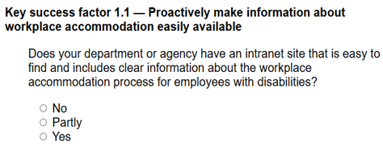
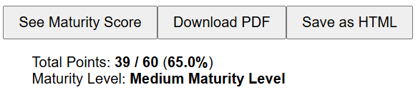
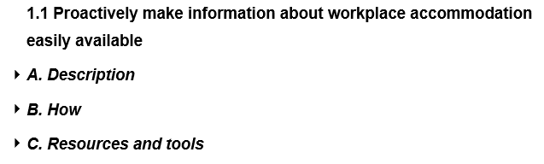
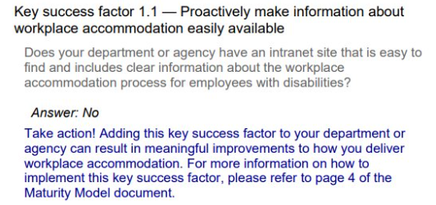
Maturity Self-Assessment Tool – Demo
3
1
4
2

Slide 13


Toolkit for Service Users
2. Consultation & Decision
0. Proactive accommodation awareness
1. Barriers and potential solutions
4. Monitoring & continuous improvement
3. Implementation and support
The workplace accommodation journey for employees with disabilities (Process map) (Annex B)
Effective behaviours for successful workplace accommodation (e.g. collaborative approach to accommodations; rights and obligations)
Tips for Employees with Disabilities to Navigate their Accommodation Journey
Tips for Managers to Navigate the Accommodation Journey (e.g. Discussion guide for managers, access to accommodation fund)
This toolkit describes effective behaviours for successful workplace accommodation and emphasizes the GC Workplace Accommodation Digital Passport as an important tool for accommodation.

Slide 14
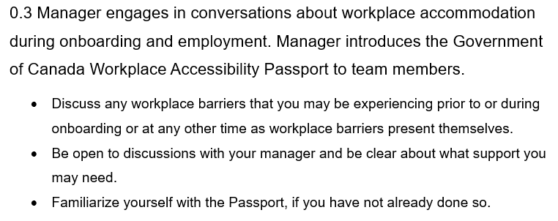
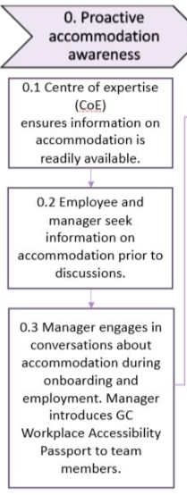
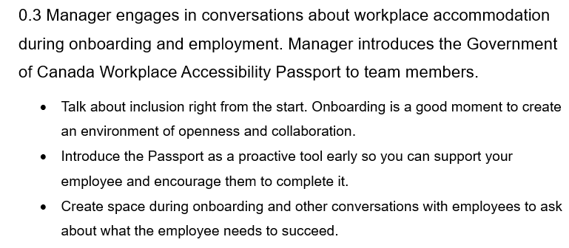
Process Map - Demo
2. a)
1
2. b)

Slide 15
How to use BAP in your role as Executives
Consult and share BAP resources with your teams
Understand the journey: The Workplace Accommodation Journey for Employees with Disabilities
Build awareness: Tips to Navigate the Workplace Accommodation Journey for Employees with Disabilities – Employee
Help with dialogue: Government of Canada Workplace Accessibility Passport
Build managers’ capacity, confidence:
Effective Behaviours for Successful Workplace Accommodation
Tips to Navigate the Workplace Accommodation Journey for Employees with Disabilities – Manager
Manager’s Guide: Requesting Medical Information for Workplace Accommodation
Support your department to do better
Make the case: Infographic - Why invest in better workplace accommodations for employees with disabilities?
Call for action: Maturity Model for a Best-in-Class Workplace Accommodation Service Delivery Model

Slide 16
Embedding the Digital GC Workplace Accessibility Passport into Departments’ Processes
Aiming to onboard 50 organizations in 2025
30 organizations already onboarded
20 more committed to onboard in November and December
OPSA's Critical path for managed onboarding
Process flow toward implementation
Memorandum of Understanding for FY2025-26 including support model
Resources and tools on dedicated GCpedia page
Adopter community of practice meetings for all organizations
For more info, contact: accessibilitypassport.passeportdaccessibilite@tbs-sct.gc.ca
Sludge Audit findings recommend mandatory Passport use to address barriers to communication, minimizing duplication of requests and enhanced support for mobility of employee between positions and Departments.
The launch of the digital GC Workplace Accessibility Passport creates an opportunity to maximize BAP improvements.

Slide 17
How you can help
BAP toolkits are for everyone
You can:
Access all BAP tools here:
Better Accommodation Project on GCpedia
Better Accommodation Project - Canada.ca
Read the toolkits and act on the learnings from BAP within your role
Champion change by sharing the toolkits within your organizations and networks
Advocate for your organization to adopt BAP learnings
Help us realize the vision of best-in-class workplace accommodation!

Slide 18
Annexes

Slide 19
Annex A - Best-In-Class Service Delivery
There are clear Key Success Factors for best-in-class workplace accommodation and they are:
1. Adopt and promote a clear approach to accommodation service delivery
1.1 Proactively make information about workplace accommodation easily available
1.2 Enable timely and collaborative workplace accommodation practices
1.3 Establish a central service point for employees with disabilities to easily make workplace accommodation requests
5. Ensure continuous improvements to workplace accommodation service delivery for employees with disabilities
5.1 Track and report data to drive service improvements
5.2 Develop, implement and monitor progress on meeting service standards
2. Develop and maintain expertise in workplace barriers and solutions
6. Build and maintain a culture of belonging that supports workplace accommodation
2.1 Establish expertise and skills internally to deliver an end-to-end service
2.2 Obtain additional information and expertise when needed
6.1 Mandate training on accessibility and disability inclusion for all employees
6.2 Provide targeted training for those delivering accommodation services for employees who deliver workplace accommodation services, including managers
6.3 Take a ‘nothing without us’ approach
3. Use verified solutions
3.1 Create a list of workplace accommodation solutions approved for use by employees with disabilities
3.2 Use standing offers, supply arrangements or acquisition cards to purchase high-demand workplace accommodation solutions
3.3 Allow employees to try out solutions
7. Establish and clearly communicate who is responsible for accommodation in your organization
7.1 Identify a single executive to oversee the delivery of the end-to-end workplace accommodation process
7.2 Make executives responsible for service enabler functions accountable for their areas and promote their collaboration with the executive in charge of the overall workplace accommodation service delivery process
7.3 Adopt a clear and transparent accountability framework for senior leaders in your organization
4. Design an effective service delivery approach
4.1 Implement an end-to-end case management approach
4.2 Develop a coordination mechanism
4.3 Use a centralized budget to purchase workplace accommodations

Slide 20
Annex B - The workplace accommodation journey for employees with disabilities (Process map)
1. Barriers and potential solutions
4. Monitoring and continuous improvement
0. Proactive accommodation awareness
2. Consultation and decision
3. Implementation and support
0.1 Centre of expertise (CoE) ensures information on accommodation is readily available.
1.1 Initial meeting between employee and manager using the GC Workplace Accessibility Passport.
2.1 CoE reviews the request and gathers relevant information.
3.1 CoE coordinates with service enablers for procurement and implementation.
4.1 Once implemented, employee documents the solution(s).
2.2 CoE consults with manager and employee.
3.2 Manager and employee collaborate with CoE to implement accommodation solutions.
0.2 Employee and manager seek information on accommodation prior to discussions.
1.2 Manager addresses workplace barriers and attempts to provide solutions.
4.2 CoE tracks implementation of accommodation.
2.3 CoE provides
recommendations for an accommodation plan
4.3 Adjustments or follow ups are made if the situation evolves.
0.3 Manager engages in conversations about accommodation during onboarding and employment. Manager introduces GC Workplace Accessibility Passport to team members.
1.3 If more support is needed, the request is submitted to the CoE.
3.3 Employee receives and tests accommodation solution.
2.4 CoE recommendation is reviewed, and final approval is given.
4.4 Data and trends are analyzed to improve future processes.
1.4 Refer to GC Workplace Accessibility Passport
3.4 Additional support is provided (if needed).
20

