Slide 1


Cultural Humility: A Lifelong Journey
Ombuds Office | IDEA Secretariat | Informal Conflict Management Office
Bureau de l’ombuds | Secrétariat de l’IDÉA | Bureau de gestion informelle des conflits
People First. Our Promise to You.
Les gens d’abord. Notre promesse à vous.
Dr. Nadia Ferrara
( wìn | she | her )
Ombuds
Indigenous Services Canada and the Privy Council Office

Slide 2

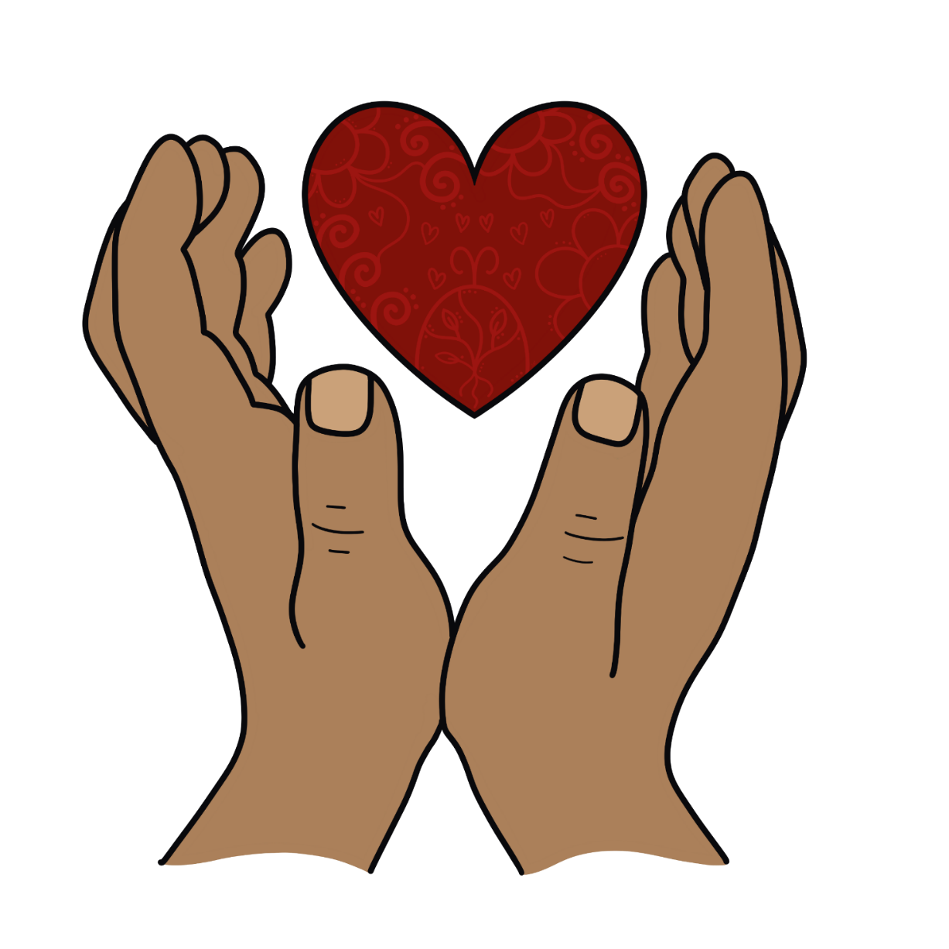
Artist: Emily Brascoupe-Hoefler
2

Slide 3
It is through our humility that
we connect with our humanity
3

Slide 4

Humility
Originates from the Latin word humilis (grounded) and humus (earth)
Not about weakness, but about understanding our place in the larger order of things
Involves admitting our shortcomings, and actively seeking to address them
A way of being that embraces constant self-correction and self-improvement
Helps us become better learners and problem-solvers

Slide 5
The Cultural Part of Cultural Humility
One’s cultural identity is intersectional and it includes:
Ethnicity, race, age, experience, education, socio-economic status, gender, sexual orientation, religion, geography (including rurality), disability, language

Slide 6
What Cultural Humility Isn’t
  Cultural Competence: is knowledge-based, and suggests that we can become an expert in someone else’s culture and experiences, allowing us to work with them more effectively
  Cultural Sensitivity: is being aware of cultural differences and the ways in which they influence our values, beliefs and behaviors, without assigning judgment
  Cultural Safety: is based on recognizing and challenging power imbalances and inequities, and invites critical reflection of our beliefs, biases, and practices

Slide 7
Cultural Humility Defined
  A lifelong journey of self-reflection and self-evaluation
  A commitment to understanding and respecting different points of view
  A willingness to learn from others
  An approach that recognizes the role of power, privilege, and oppression in shaping our interactions with others
  A way of being for moving us towards equity

Slide 8
An Ongoing Process
  There must be an ongoing process of self-reflection and self-evaluation as it relates to working with those who are different from ourselves ​
  Recognize that we are the experts of our own lived experience​s
  Reflect on your own assumptions and biases and consider how they impact your worldview
  This is an individual process that invariably leads to organizational change

Slide 9
Two Pillars: Self-reflection & Self-evaluation
  Self-Reflection:
    What assumptions am I making about…?
    Am I overgeneralizing? Jumping to conclusions? Magnifying or minimizing?
    Am I letting my values/belief systems get in the way?
  Self-Evaluation:
    Have I gone to a reliable source for information/insight? What do I believe now?
    Have I challenged my source of knowledge? Was any of my information false or ill informed?
    Is there new information available? What has changed?

Slide 10
The 5 R’s of Cultural Humility
  Reflection aim: One will approach every encounter with humility and understanding that there is always something to learn from everyone. Ask: what did I learn from each person in that encounter?
  Respect aim: One will treat every person with the utmost respect and strive to preserve dignity and respect. Ask: did I treat everyone involved in that encounter respectfully?
  Regard aim: One will hold every person in their highest regard while being aware of and not allowing unconscious biases to interfere in any interactions. Ask: did unconscious biases drive this interaction?
  Relevance aim: One will expect Cultural Humility to be relevant and apply this practice to every encounter. Ask: how was Cultural Humility relevant in this interaction?
  Resiliency aim: one will embody the practice of Cultural Humility to enhance personal resilience and global compassion. Ask: how was my personal resiliency affected by this interaction?
Source: The American Journal of Medicine, Vol 134, No 2, February, 2021

Slide 11
Cultural humility is a pathway to both personal and institutional accountability
11

Slide 12
Cultural Humility Promotes Institutional Change
Practicing Cultural Humility creates ripple effects that lead to more inclusive and equitable workplaces
  Each of us can make a difference
Institutional change starts with individual commitment to being better and doing better
  Organizations are made of people
We must lead and encourage the organization to actively engage in constant self-evaluation, to uncover and address systemic barriers, power dynamics, and inequities that exist within

Slide 13
Personal Resistance looks like…
Refusal to change/ rigid/ unwilling to learn or connect
Strategic ignorance / upholding biases or myths
Lack of self-reflection, self-awareness or honesty / fear of judgement
Ego or superiority complex/ self-centeredness
Unwillingness to demonstrate vulnerability or admit to a lack of knowledge
No consideration for lived experience or specific cultural differences
Refusal to accept accountability / “not my problem” mentality
These views often show up as bullying, harassment, abuse of power, and micro-aggressions

Slide 14
Institutional Resistance looks like…
Resistance to new approaches
Implementing policies without sufficient input from stakeholders
Upholding policies or procedures that maintain systemic barriers
Rigid hierarchical systems that inhibit inclusive decision-making and participation
Marginalization of equity-denied groups and lack of such voices in important leadership positions
Unchecked offensive behaviors, such as microaggressions

Slide 15
Microaggressions Defined
A subtle verbal or nonverbal behavior, committed consciously or not, often by well-intentioned individuals who are unaware they are engaging in an offensive or demeaning form of behavior

Slide 16
Examples of Microaggressions
Racial: assuming a person of color is ‘not from here’, not acknowledging or invalidating a person's racial identity or lived experiences
Gender: assuming a person's gender identity or pronouns based on their physical presentation
Ability: disregarding the needs of individuals with disabilities, assuming a person's capabilities, using ableist language (such as, ‘this is falling on deaf ears’, ‘the blind leading the blind’, ‘you’re so OCD’)
Age: assuming an older person is not tech-savvy, not valuing the contributions of older workers, thinking younger workers are not as qualified as those with more experience

Slide 17
Microaggressions are felt by all who are victimized by strategic ignorance
17

Slide 18
Impact Matters – The Toll of Microaggressions​
Microaggressions can make us feel like: ​
  We do not belong​
  We must constantly explain or defend ourselves to friends, colleagues and managers/supervisors​
  We are consistently othered, belittled or ignored in workplace settings​
  There is something inherently wrong with us
Microaggressions can inflict tremendous harm and can lead to depression and anxiety
Ultimately, microaggressions are about impact rather than intent

Slide 19
Institutional change looks like…
  Creating a culture of psychological safety where microaggressions and offensive behaviors can be identified and effectively addressed
  Organizational self-reflection and self-evaluation on current levels of inclusion, diversity, equity, and accessibility (IDEA)
  Regular reviews of policies and procedures to identify differential impacts on marginalized groups
  Embedding measurements like 360° Feedback and employee surveys to evaluate organization’s IDEA performance
  Support employee resource groups and offer IDEA training and resources

Slide 20
Transform microaggressions to microaffirmations
Transform lateral violence to lateral compassion
20

Slide 21
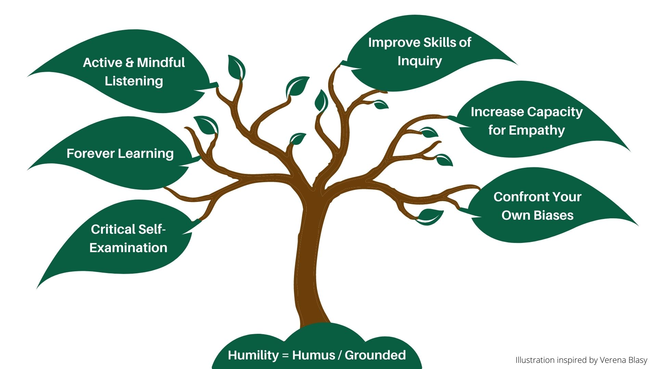
It All Starts With You
Illustration inspired by Fern Blasy
21

Slide 22
Cultural Humility is…
About seeing ourselves, our organizations, the past and the present truthfully, learning from these insights, and using them to do better, and to be better
An ongoing process recognizing the person in front of you as the expert of their lived experience
The great connector as it leads to meaningful and compassionate change
A lifelong journey

Slide 23
“People will forget what you said, people will forget what you did, but people will never forget how you made them feel.”
- Maya Angelou
23

