Slide 1


Fewer Priorities, Better Executed: Transforming Strategy
September 11, 2024
Craig Szelestowski
Telfer Executive Programs
Notes:
I would like to begin by acknowledging that the land from which I speak to you today is the traditional unceded territory of the Algonquin Anish-naa-beg People.
The Algonquin peoples have lived on this land since time immemorial. I am grateful to have the opportunity to live and work in this territory.

Slide 2
Learning Objectives
What is the cost of too many priorities?
How can we reduce the number of priorities?
How can we better execute our remaining priorities?
Three things to try out.

Slide 3
Learning Objectives
What is the cost of too many priorities?
How can we reduce the number of priorities?
How can we better execute our remaining priorities?
Three things to try out.

Slide 4


Slide 5

Too many tasks at same time…
When we “multi-task*”, we get less done.
_{*actually, “switch-task”}
Notes:
This is a killer.

Slide 6
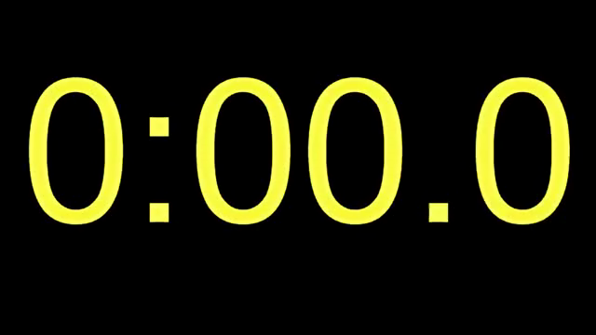
Time Yourself
Scenario 1 (Focus-Tasking)
1. Write:
Multitasking eats time
1 2 3 4 5 6 7 8 9 10 11 12 13 14 15 16 17 18 19 20
2. Note in the chat how long that took.

Slide 7
Time Yourself
Scenario 2 (Context Switching)
1. Write one letter, then one number, one letter, one number, etc:
Multitasking eats time
1 2 3 4 5 6 7 8 9 10 11 12 13 14 15 16 17 18 19 20
2. Note in the chat your 1st round and 2nd round times.
Notes:
Why did this take so much longer?
What is this context switching? Does this apply to us when we are constantly switching between multiple files?
Context swiching:
Care and feeding of multiple files
Familiarizing and re-familiarizing yourself with multiple files instead of adding value to them - actually can take hours. Ever put down a file and pick it up a week later? How much time did you spend re-reading and re-thinking it – that you wouldn’t have had to spend if you had been able to work through it uninterrupted.

Slide 8
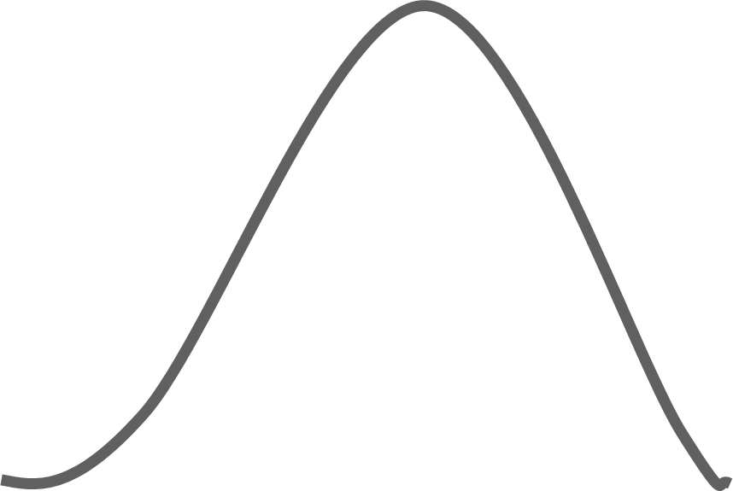
Yerkes-Dodson Curve
Optimum Stimulation
-creativity
-rational problem solving
-progress
-change
-satisfaction
Overstimulation
-reduced creativity
-ineffective problem solving
-difficult to focus
-reduced efficiency
-illness
LO PERFORMANCE HI
Under-
Stimulation
-boredom
-fatigue
-frustration
-dissatisfaction
LO STRESS HI
Yerkes RM, Dodson JD . "The relation of strength of stimulus to rapidity of habit-formation". Journal of Comparative Neurology and Psychology 18: 459–482
Notes:
So context switching creates the Lean waste of MURI or overwhelming our people.
Some stress is good – it enhances productivity and creativity and mental analysis acuity.
However, when people are overwhelmed, they simply are not good at these deep thinking tasks – the fight or flight part of their brain takes over – and all they’re good at is making to-do lists – but not getting started on the big, value stuff. A person can spend a half day at a time spinning their wheels.

Slide 9
Cost of Too Many Priorities
# simultaneous projects | % of time available for each project | % time lost to switching | Hours per week lost (per person)
1 | 100% | 0% | 0 hours
2 | 40% | 20% | 6 hours
3 | 20% | 40% | 12 hours
4 | 10% | 60% | 18 hours
5 | 5% | 75% | 22 hours
From: Weinberg, Gerald M. Quality Software Management (New York: Dorset House)
Notes:
Jerry Weinberg is a software and systems thinker who did extensive research to quantify the cost of context switching in the development of software. Here’s what he found:
He studied thousands of software development projects – and quantified how much productive time was lost to context switching.

Slide 10
What problems are likely to happen to a file that takes 12 months to finish versus the same file that takes 12 focused days to finish?

Slide 11
Learning Objectives
What is the cost of too many priorities?
How can we reduce the number of priorities?
How can we better execute our remaining priorities?
Three things to try out.

Slide 12
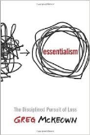
“Try to do it all” vs. “Focus and Complete the Critical Few”?
Your Team’s capacity
Your Team’s capacity
Execute the “Critical Few”
(same amount of effort, but focused)
Do it all.
It’s all important!
Notes:
Isn’t it better to completer a smaller number of things than not make small or tiny progress on all things?
Get the group to discuss this notion – is it true? Does it apply to us? Do we REALLY have to do it all?

Slide 13
How can we reduce the number of priorities we pursue?
Start with the problem to be solved, instead of “initiatives”
Sort into “Must-Do, Can’t Fail” vs “Should Do” vs “Don’t Do”
Estimate capacity available and capacity required

Slide 14
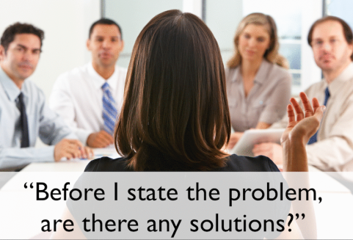
Notes:
Why is it useful to define a problem statement before identifying solutions?
Have you ever been to this meeting?
Participant 1: We did X when I worked at Environment Canada, and it worked really well
Participant 2: Yes, but we did Y when I was at Finance Canada.
Participant 3: That`s all good, but we had an excellent experience when we did Z at IRCC.
We spin in circles because we are comparing opinions of what works.
But wouldn`t it be easier to figure out what solution to choose if we had a problem to compare the solution to?

Slide 15

Without a specific, well-defined “problem to solve”,
we may develop elaborate, elegant
shiny objects
that don’t solve the problem.
So the problem persists.

Slide 16
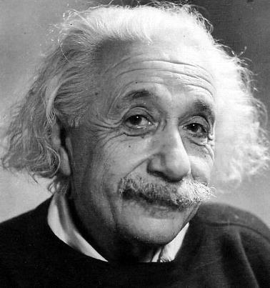
With a clearly-defined problem, the solution takes less effort
“If I had an hour to solve a problem, I'd spend 55 minutes thinking about the problem and 5 minutes thinking about solutions.”

Slide 17

Illustration: Understand the complex chain of events
Upstream
Downstream
Work overtaken by events or no longer relevant
Projects / requests too broad, vaguely-stated, unclear definition of “done”
Work takes a long time to get done
Scope creep
Solution:
Business writing training course
Over-consultation Over-collaboration
Over-delivering
File info becomes stale, must be updated, go back thru process
We’re busy, so work scheduled over long periods instead of focused time F2F and completed
Running out of time
= rushing
= stress
= errors, missing info, lack clarity
Spend time fixing errors, editing omissions, seeking clarifications
Takes effort to retrace steps each time picked up again
Spend time providing / requesting status updates
Lose momentum – slow work appears to be low priority work
Too much time in meetings, too many emails
Takes more effort to get the work done
Too busy – lose efficiency – Fight, Flight or Freeze, switch-tasking.

Slide 18
To create clarity, go upstream to root causes
Upstream
Downstream
Work overtaken by events or no longer relevant
Projects / requests too broad or vaguely-stated, unclear definition of “done”
Work takes a long time to get done
Scope creep
Solution:
Business writing training course
Over-consultation Over-collaboration
Over-delivering
File info becomes stale, must be updated, go back thru process
We’re busy, so work scheduled over long periods instead of focused time F2F and completed
Running out of time
= rushing
= stress
= errors, missing info, lack clarity
Spend time fixing errors, editing omissions, seeking clarifications
Takes effort to retrace steps each time picked up again
Spend time providing / requesting status updates
Solution:
define projects / requests more precisely at start, with definition of “done”
Lose momentum – slow work appears to be low priority work
Too much time in meetings, too many emails
Takes more effort to get the work done
Too busy – lose efficiency – Fight, Flight or Freeze, switch-tasking.

Slide 19
Benefits of starting with the problems to be solved
Because they create specific impact, problems are easier to rank/prioritize than initiatives – in the absence of a clear problem to solve, most initiatives look interesting, so we don't say "no" as often as we should.
Problems have causes – solve upstream causes and multiple problems are often solved versus chasing symptoms.
Problems are specific and actionable. Easier to identify when a problem is solved; creates a “finish line”.
Identifies duplicates, or in competition/conflict with each other.

Slide 20
Highest Value
Must-do, can’t fail
Breakthrough (e.g. creates critical capabilities / frees-up significant capacity)
Should do (e.g. Adds value or relieves symptom not root cause)
Could do (e.g. nice to have)
Do not do
Pet project
Shiny object
Everyone else is doing it priority
Lowest Value

Slide 21



Notes:
Ask the group how they decide.
An exercise to get the group to think how criteria can be used to determine which priorities to do and which not to do.
The group will come up with things like:
“how long since I last wore it?”
“when would I be likely to wear it again?”
Try to get the group to come up with as specific examples as possible. Write them on the flipchart.
Ultimate suggestion: “If I didn’t own this exact item, how much would I be willing to pay for it, in order to have it?”
This gives you a number that you can use to compare different garments.
We must COMPARE options in order to determine which stay and which go

Slide 22
Your unit’s capacity
Supporting Corporate priority projects
Running day-to-day
operations
Implementing
Central Agency
priorities
Transformational
projects to deliver own
operational functions
more efficiently
Others?
Can you really get it all done in the next 12 months?

Slide 23
How much capacity is available?
How many people days (outside of delivering the day-to-day business) are available per major job group in the team?
Start with a full year (260 days),
Subtract sickness and family (-10 days)
Subtract vacation leave (20 days)
Subtract day to day business
How many days are available for these priorities by job group, by quarter?
This is your “available capacity”

Slide 24
Learning Objectives
What is the cost of too many priorities?
How can we reduce the number of priorities?
How can we better execute our remaining priorities?
Three things to try out.

Slide 25

₌
Lean Approach: -Less “context switching”
-faster -less effort -less rework
_{A1}
_{A2}
_{A3}
Initiative A
₌
_{B1}
_{B2}
_{B3}
Initiative B
₌
_{C1}
_{C2}
_{C3}
Initiative C
Traditional – “it’s all important - do it all at the same time”
_{A1}
_{B1}
_{C1}
_{A2}
_{B2}
_{C2}
_{A3}
_{B3}
_{C3}
Jan Feb Mar Apr May Jun Jul Aug Sep Oct Nov Dec
Lean – “prioritize and focus”
_{A1}
_{A2}
_{A3}
_{B1}
_{B2}
_{B3}
_{C1}
_{C2}
_{C3}
Jan Feb Mar Apr May Jun Jul Aug Sep Oct Nov Dec
_{From: Jeff Sutherland, 2014.}
Notes:
The boxes are smaller in the Lean Approach – less context switching, greater focus = less effort than traditional approach
But this only works if you are able to reduce your work in progress – the number of things that you are trying to do at the same time.

Slide 26
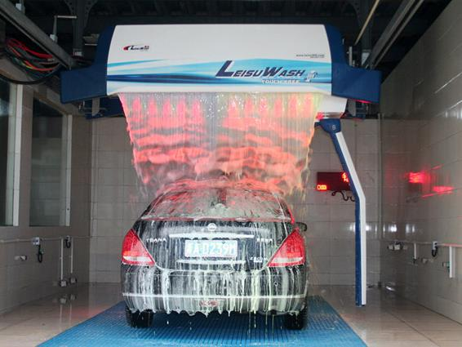

“in the history of the world, no one has ever washed a rented car.”
-Larry Summers
Notes:
What about this photo tells you that it has been doctored?
In the history of the world, no one has ever washed a rented car.
Ownership is important. If the idea, or the plan is owned by the senior execs, but not the implementers, then it is likely that the implementers will not go the extra mile to implement it.

Slide 27


Slide 28
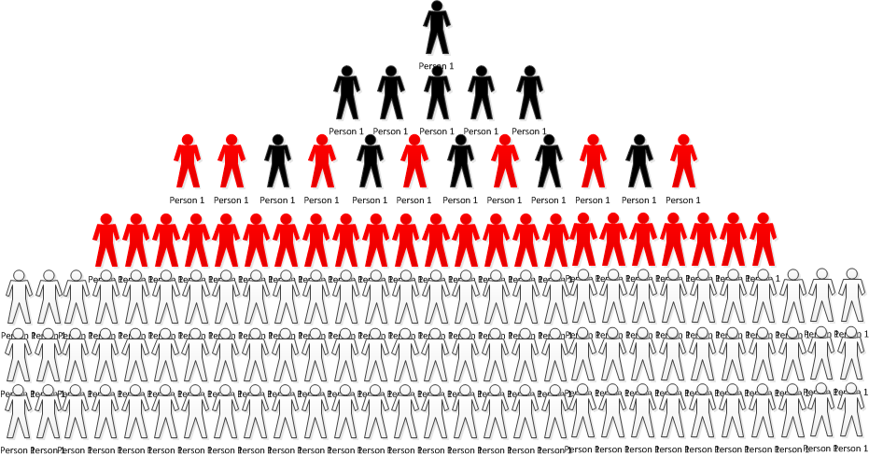


Implementers give feedback on plan, realism, how to get to Point B
“Catchball”
Notes:
Then senior management consults the next levels down to ensure plan is realistic and understanding and buy-in are increased
Avoids:
The people who plan and the people who implement the plan not being connected. Thus plans can be:
Unrealistic, not taking into account the reality on front lines;
lacking buy-in and ownership at lower levels; People support what they help create.
misunderstood at lower levels
ignored by multiple levels
hampering implementation and results

Slide 29
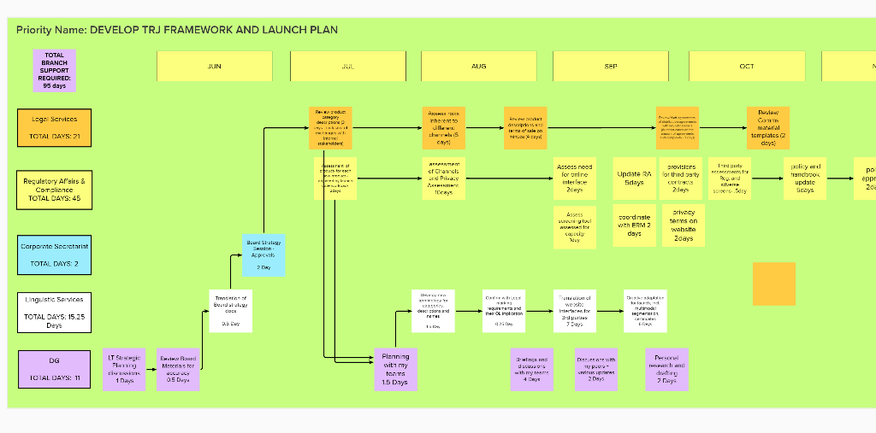

Slide 30
Traditional vs Lean Strategic Planning
_{Exec.}
_{Visibility Board}
Executives
Executives
Strategy
_{Mgmt.}
_{Visibility Board}
Strategic Management
Managers
Managers
Daily Activities
Front
Lines
_{Front Line Visibility Board}
Front
Lines
Daily Activities
Source: Kesterson

Slide 31
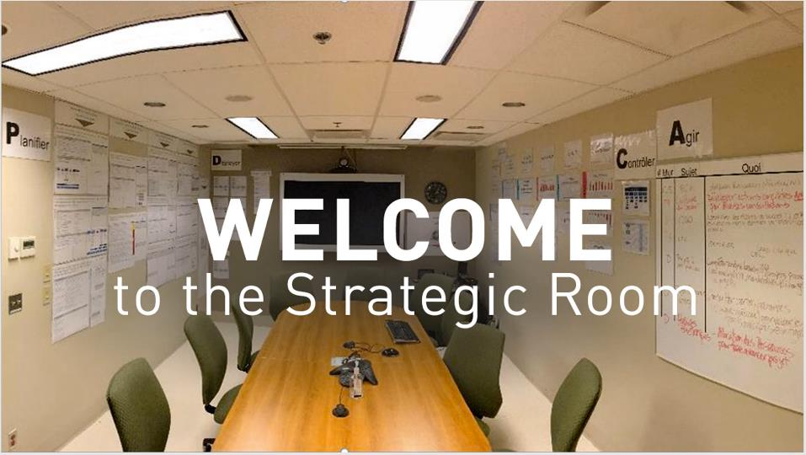

Slide 32
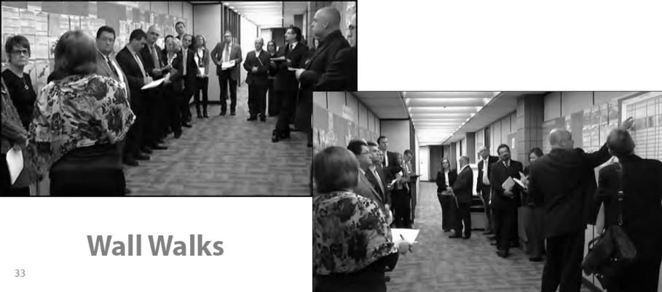
Regular Updates and Reviews: “Wall Walks”
Saskatchewan Ministry of Education DM, ADM’s and D-G’s

Slide 33
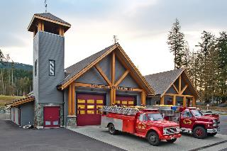

How to handle new, urgent priorities?
Keep “slack” time for urgent priorities
Monthly check-ins, visual boards to assess overload and adjust
Other?

Slide 34
Learning Objectives
What is the cost of too many priorities?
How can we reduce the number of priorities?
How can we better execute our remaining priorities?
Three things to try out.

Slide 35
Three things you can do next
Narrow Priorities Which are truly “must-do, can’t fail” versus “should do”, “could do” and “don’t do”?
Estimate Capacity Required for Each Initiative and see where the plan is unreasonable/unrealistic
Make Remaining Priorities Visible With a Regular Routine to Revisit Create visibility at all levels, with a routine to check in and adjust as you go
Article: https://leanagility.com/en/lean-strategic-planning

Slide 36
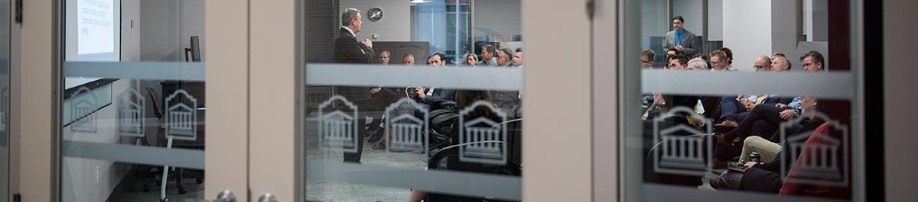
Telfer Executive Programs
At Telfer Executive Programs, we see leadership as a journey, not just a destination. Our leadership development programs are designed for executives and senior leaders. Participants expand their influence and develop leadership abilities in programs built on the first-hand experience and insight of seasoned executives, industry pioneers, leadership experts, and certified coaches.

Slide 37

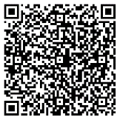
Lean Strategic Planning
Wednesday, November 6, 2024
8:30 a.m. to 4:30 p.m.
What you will learn:
What Lean Strategic Planning and Deployment are and how they differ from traditional planning and execution;
Key shortcomings of traditional strategic planning and how to address them;
How to gain consensus on the “must-do, can’t fail” versus “should do” versus “don’t do” priorities, and how to say “no, not yet” to lower-value priorities;
How to respond to unplanned, unexpected events throughout the year;
How to create ownership and alignment of the plan at all levels, from the highest executive levels to the front lines.
Learn more or register:

Slide 38
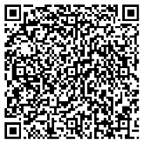
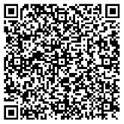
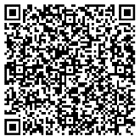
Lean and Agile Leadership Program
Cultivating Personal & Team Resilience
Public Sector Leaders Program
Other Programs of Interest – Scan to Learn More!

